Slide 1
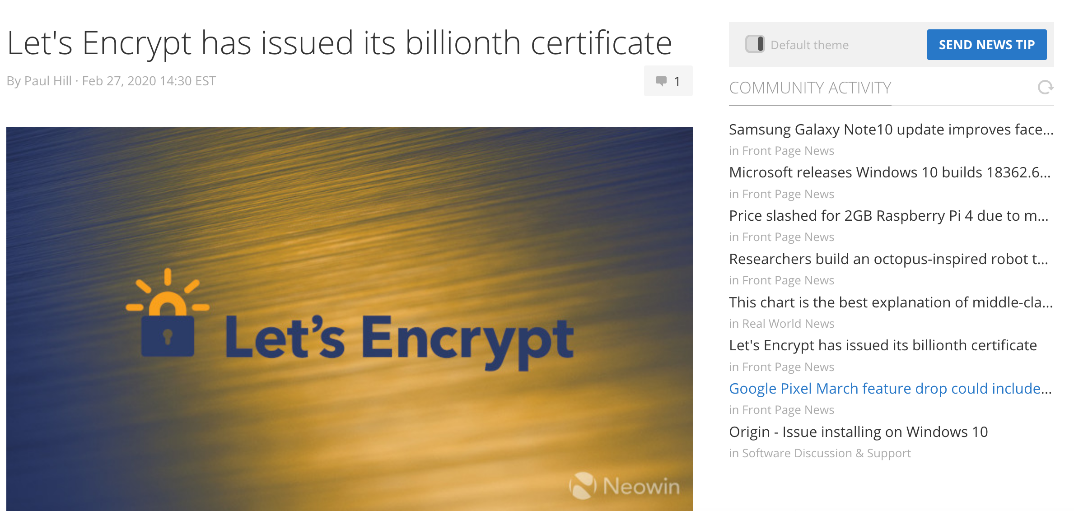
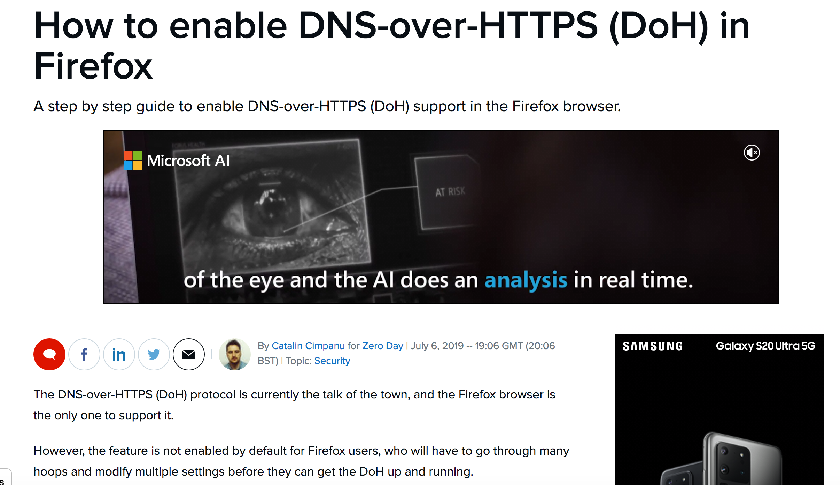
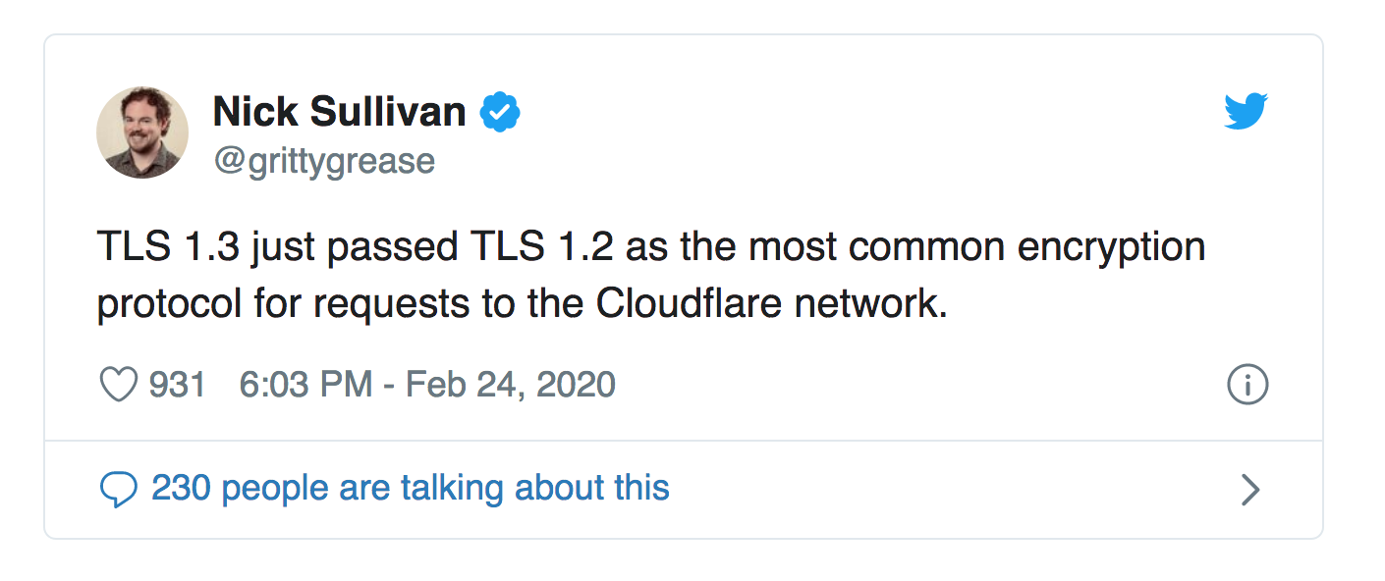

Slide 2
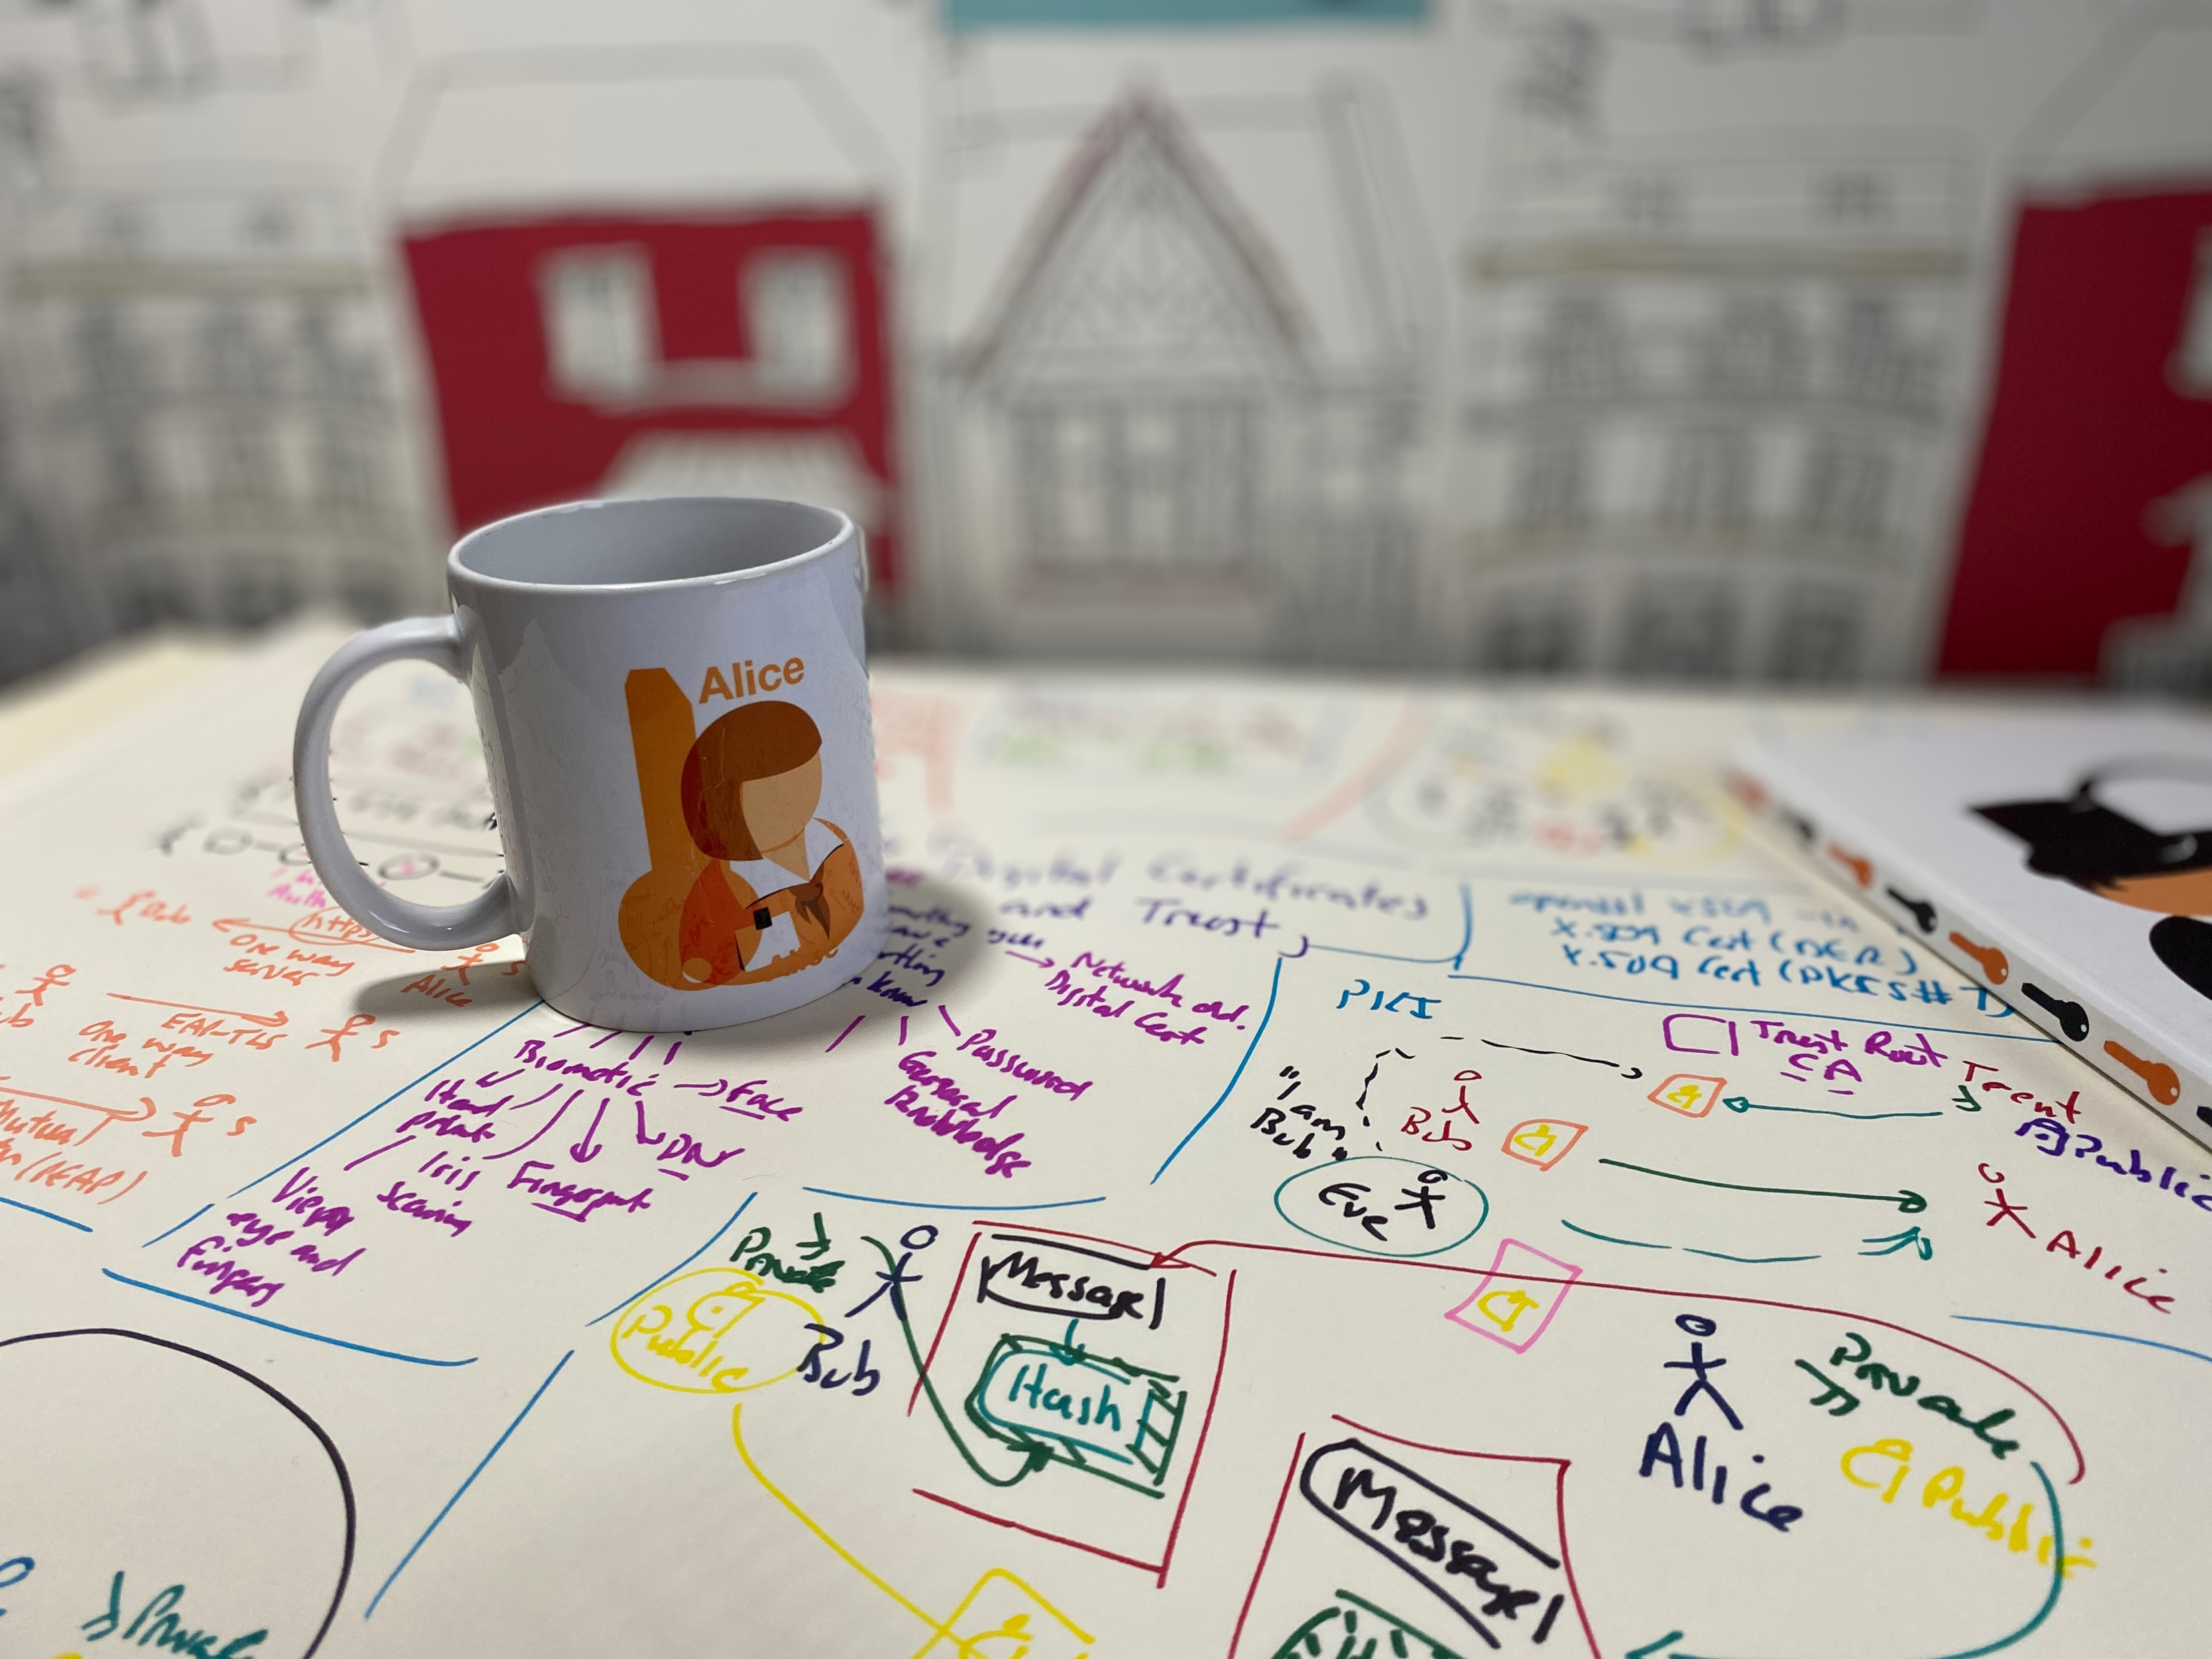
Digital Certificates Introduction Authentication Methods Public Key Infrastructures Digital Certificate Passing Digital Signatures Prof Bill Buchanan OBE https://asecuritysite.com/digitalcert/

Slide 4
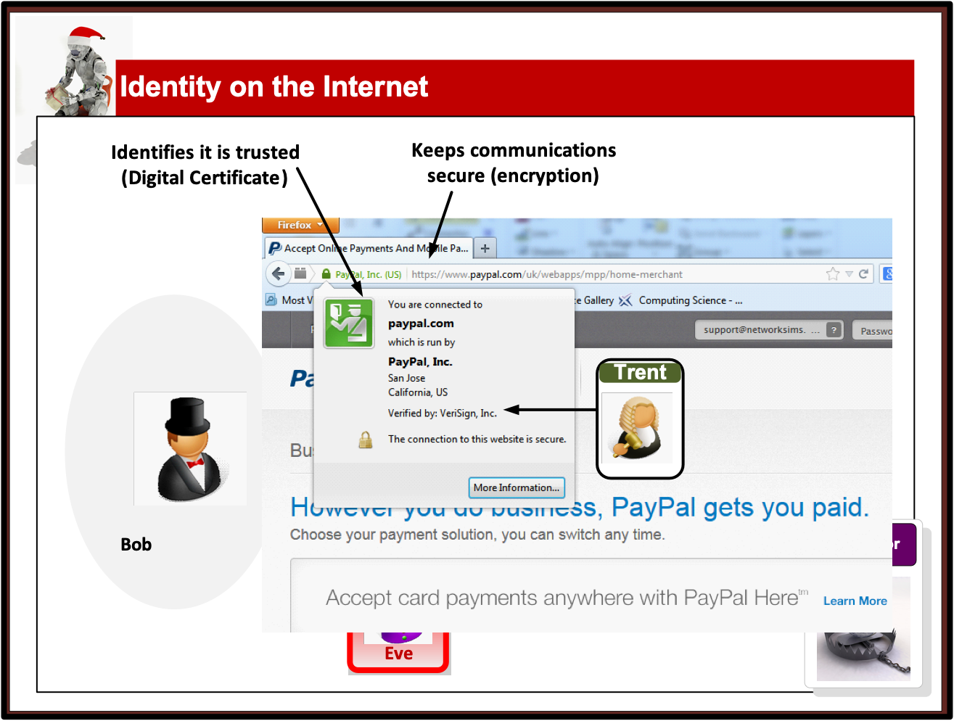

Slide 5
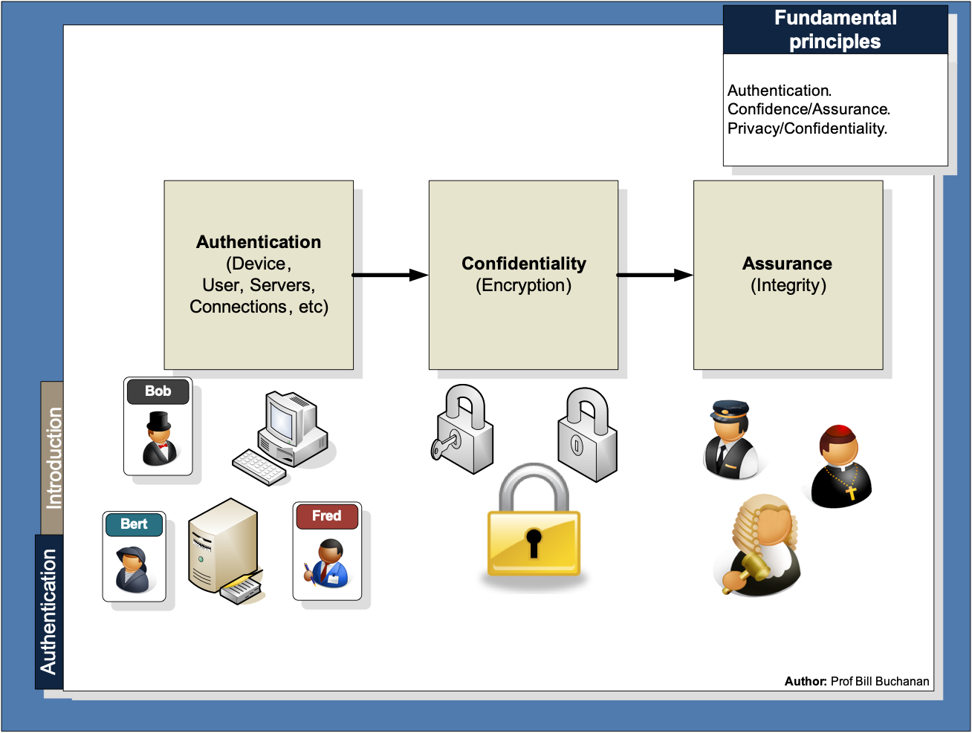

Slide 6
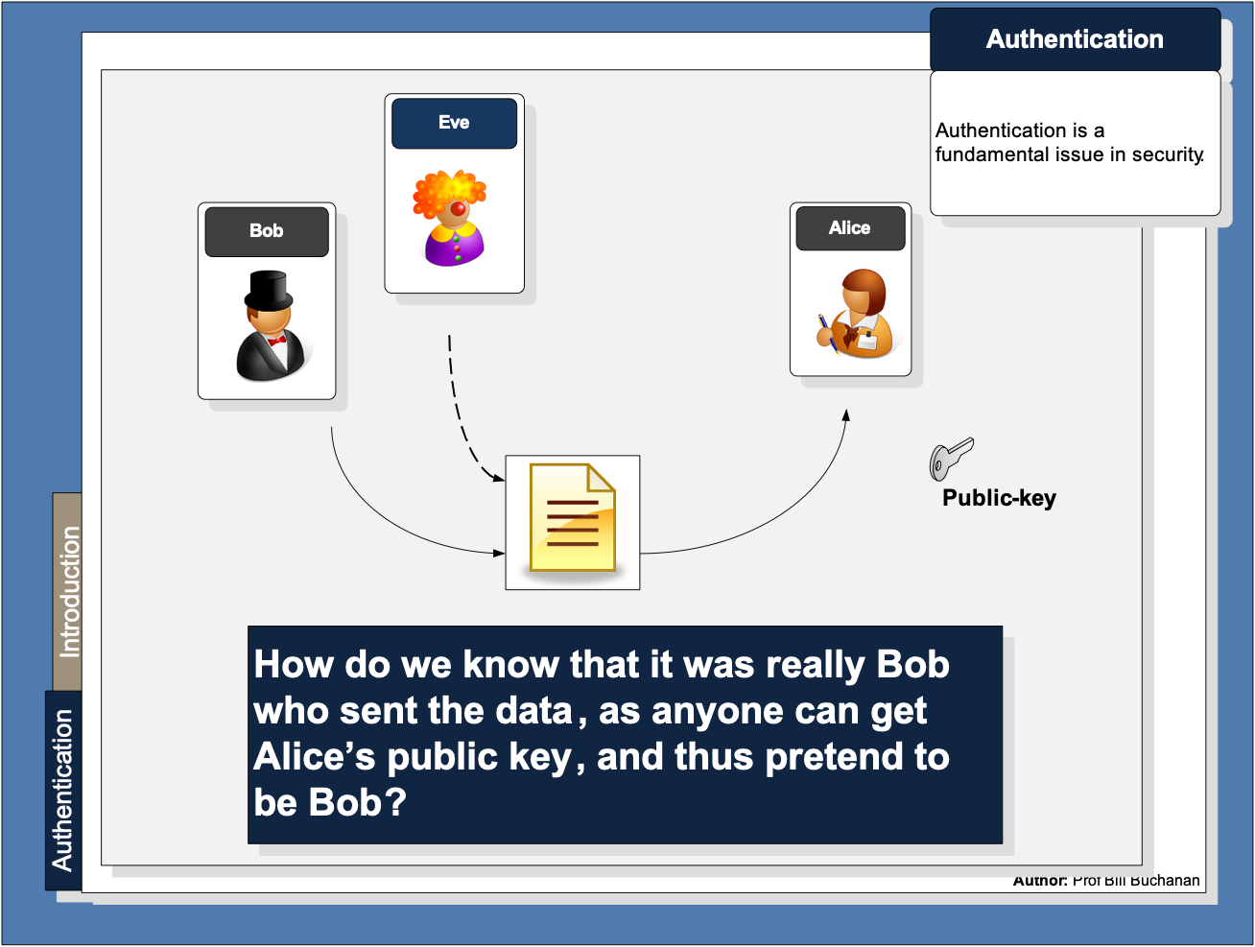

Slide 7
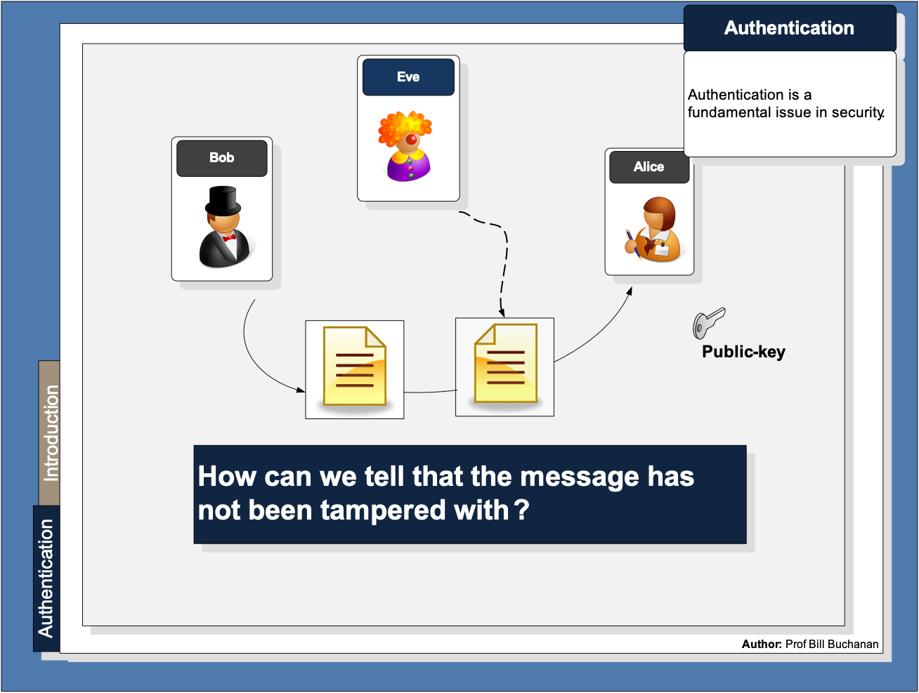

Slide 8
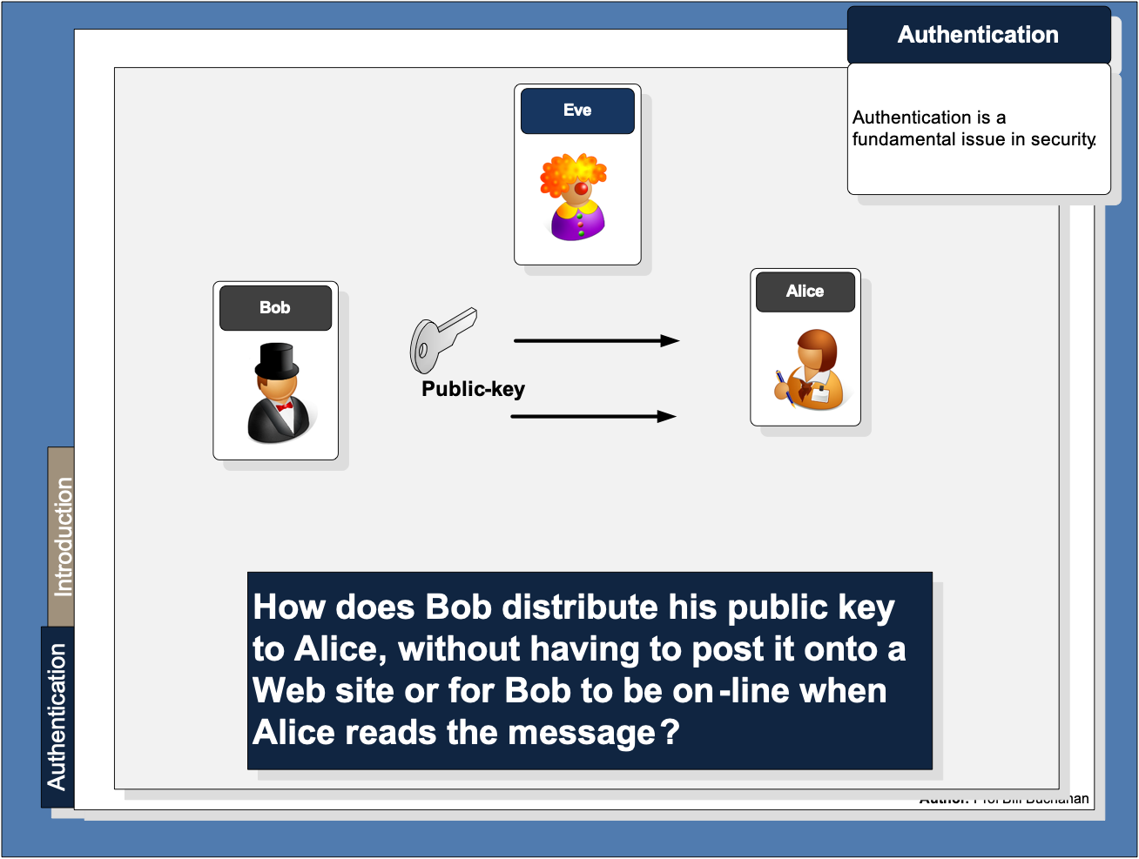

Slide 9
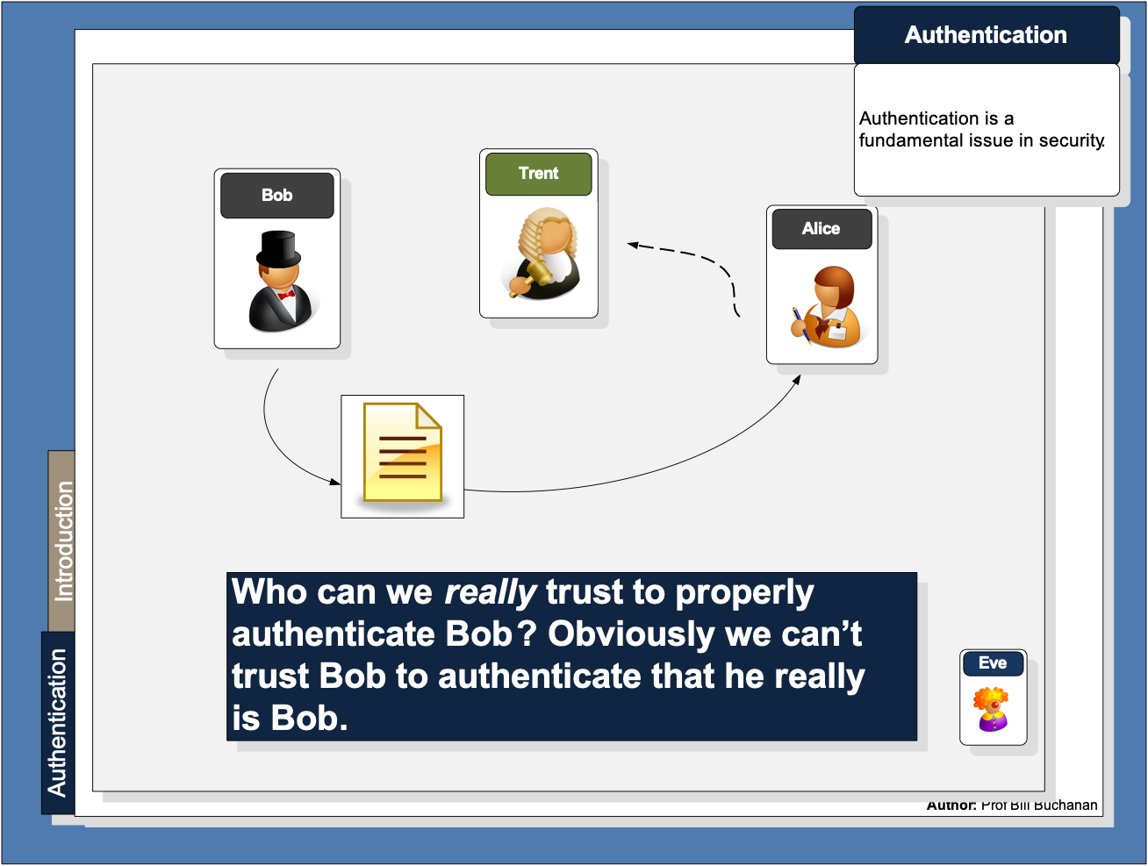

Slide 10
Unit 6: Digital Certificates Introduction Authentication Methods Prof Bill Buchanan OBE https://asecuritysite.com/digitalcert/

Slide 11
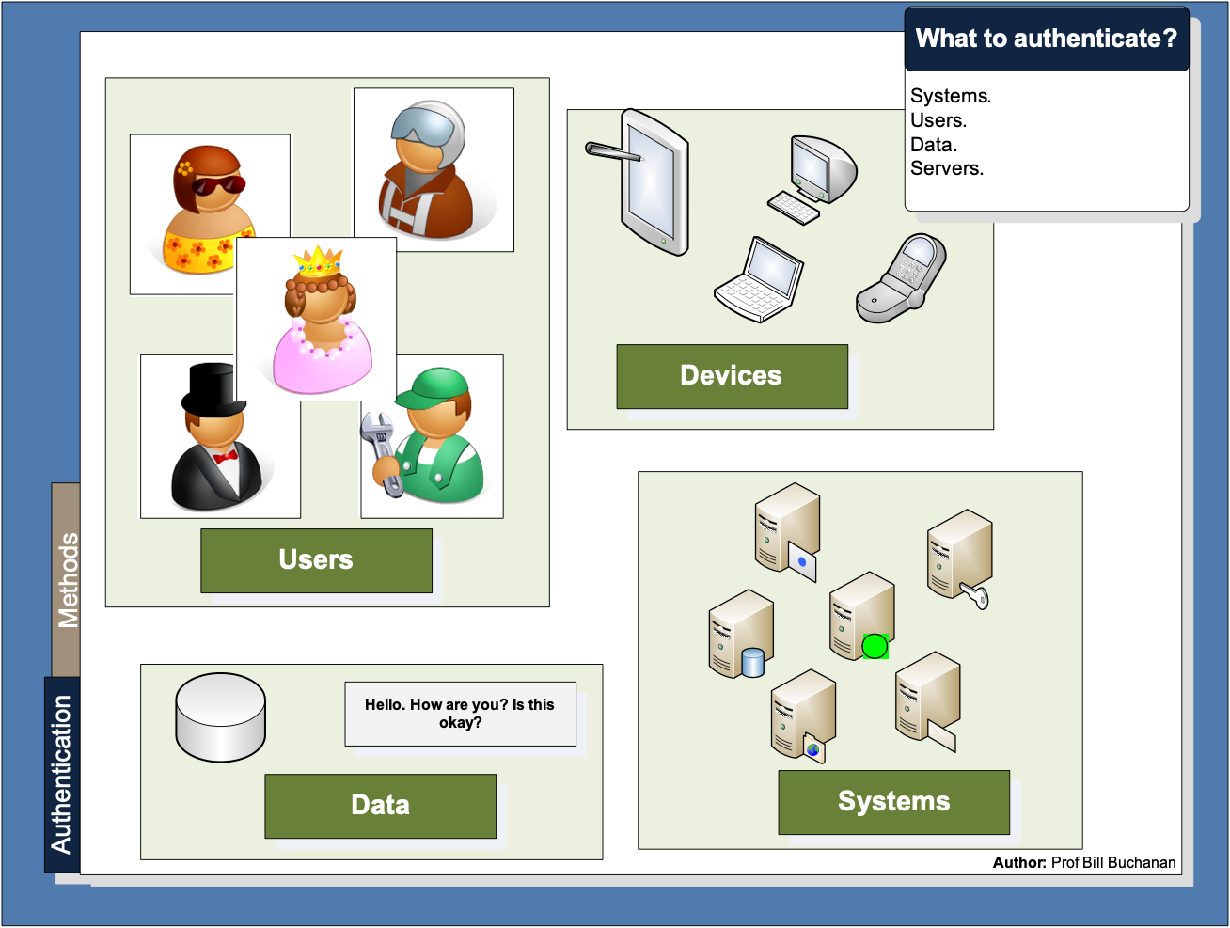

Slide 12
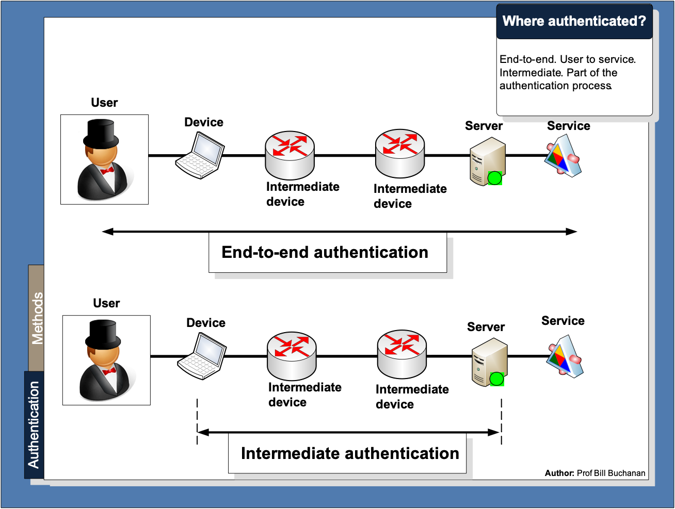

Slide 13
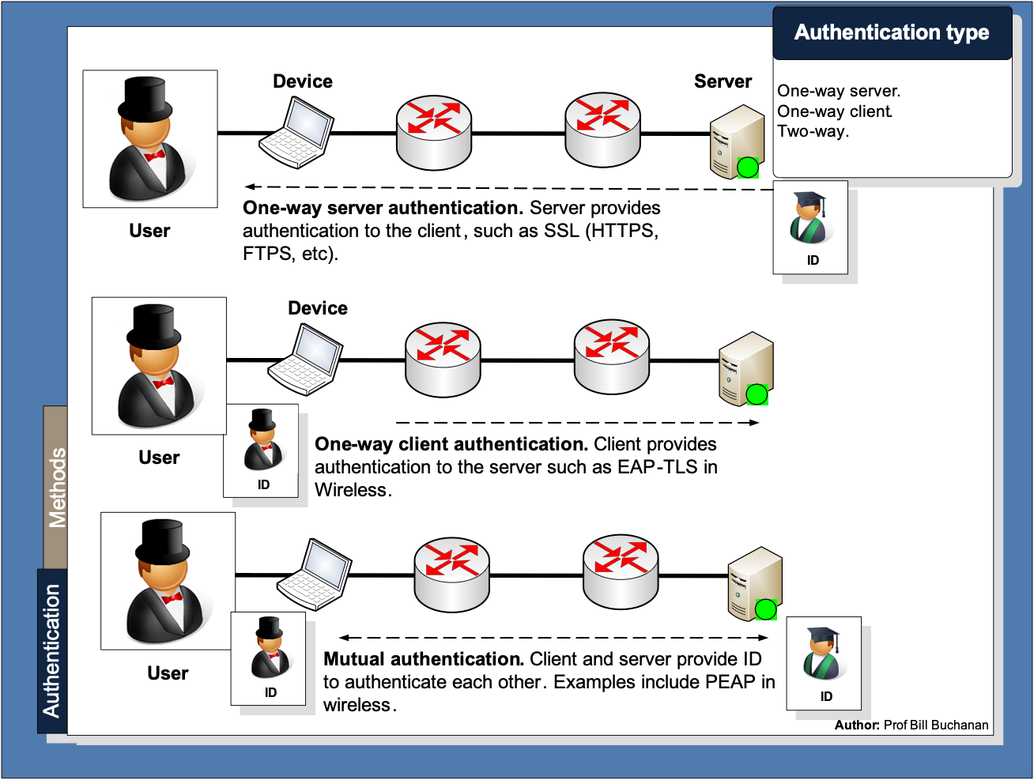

Slide 14
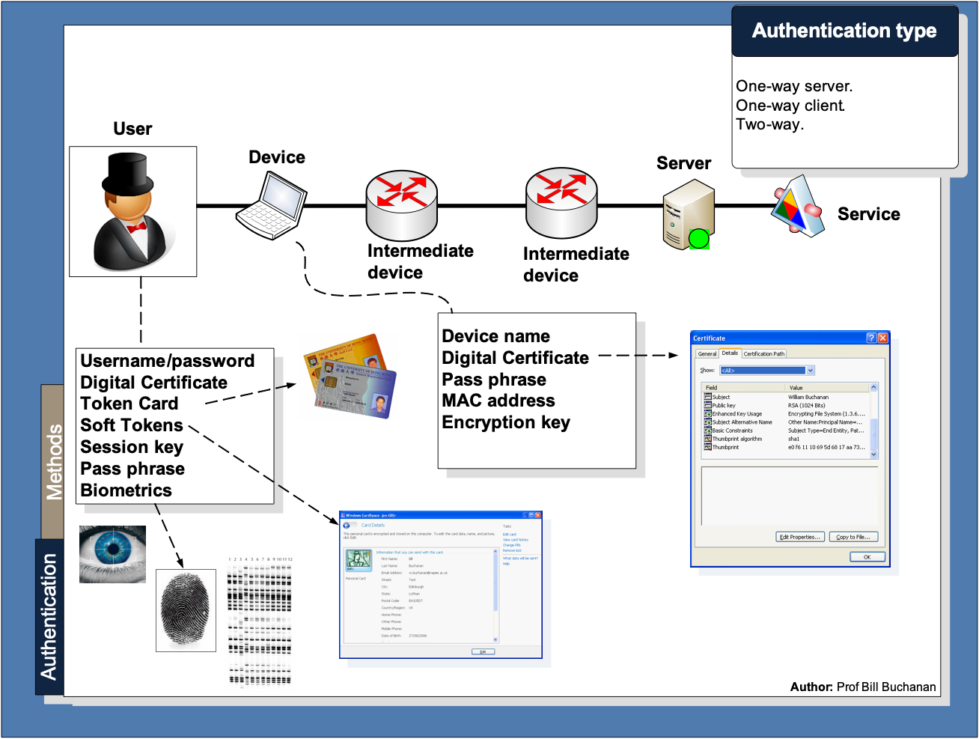

Slide 15
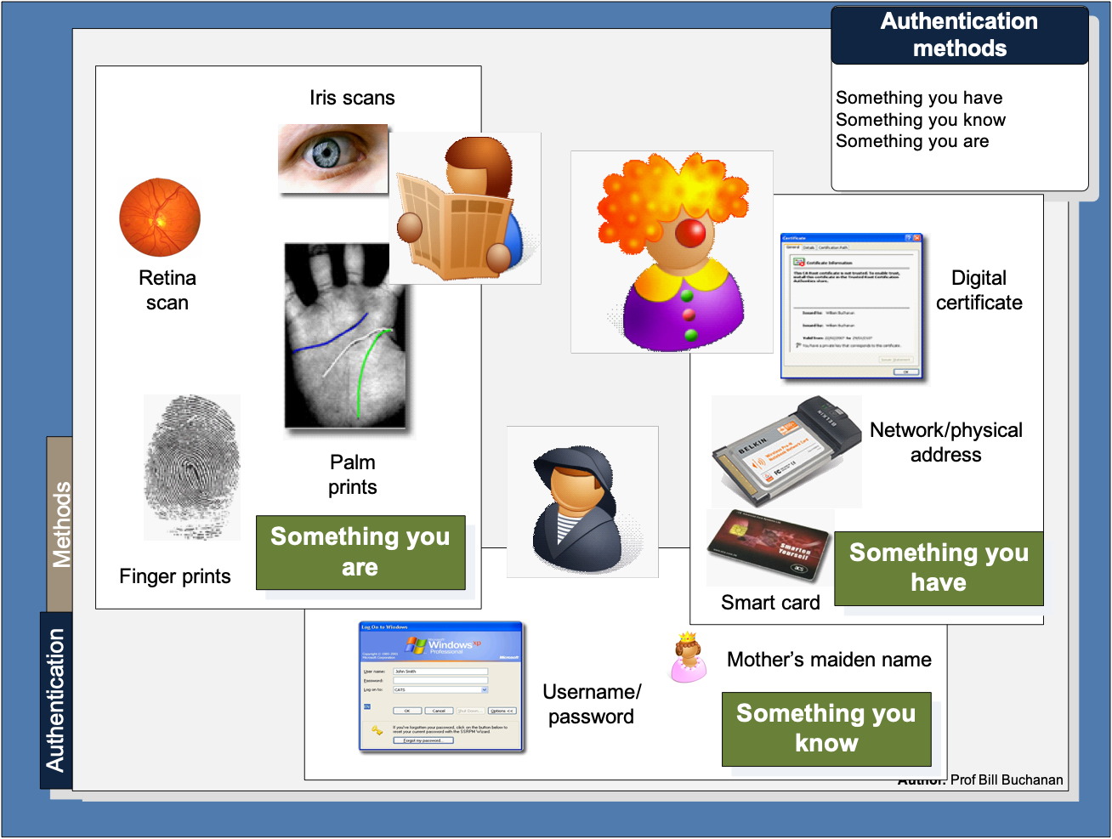

Slide 16
Digital Certificates Introduction Authentication Methods PKI Digital Certificate Passing Prof Bill Buchanan OBE https://asecuritysite.com/digitalcert/

Slide 17
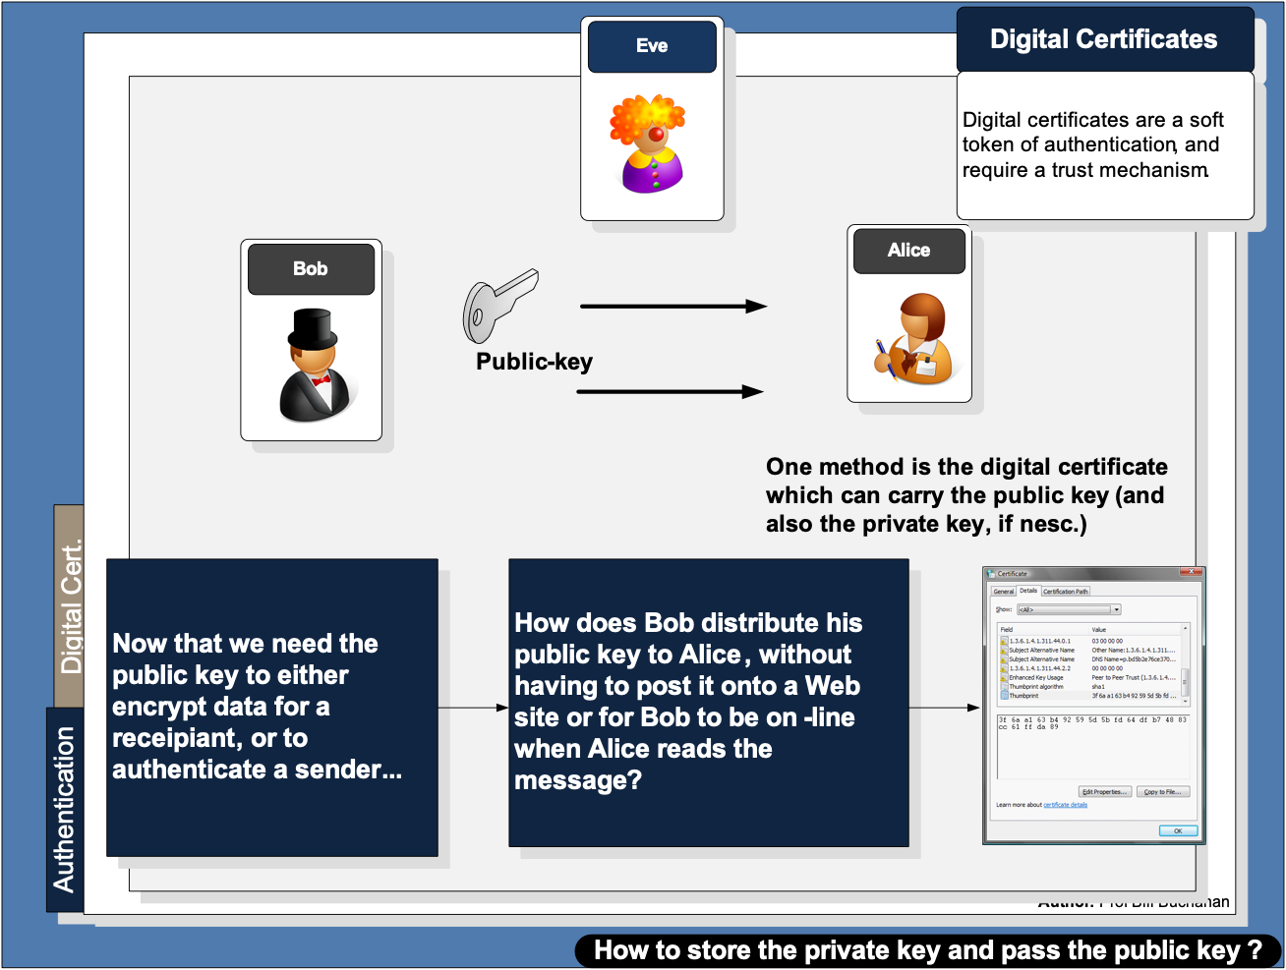

Slide 18
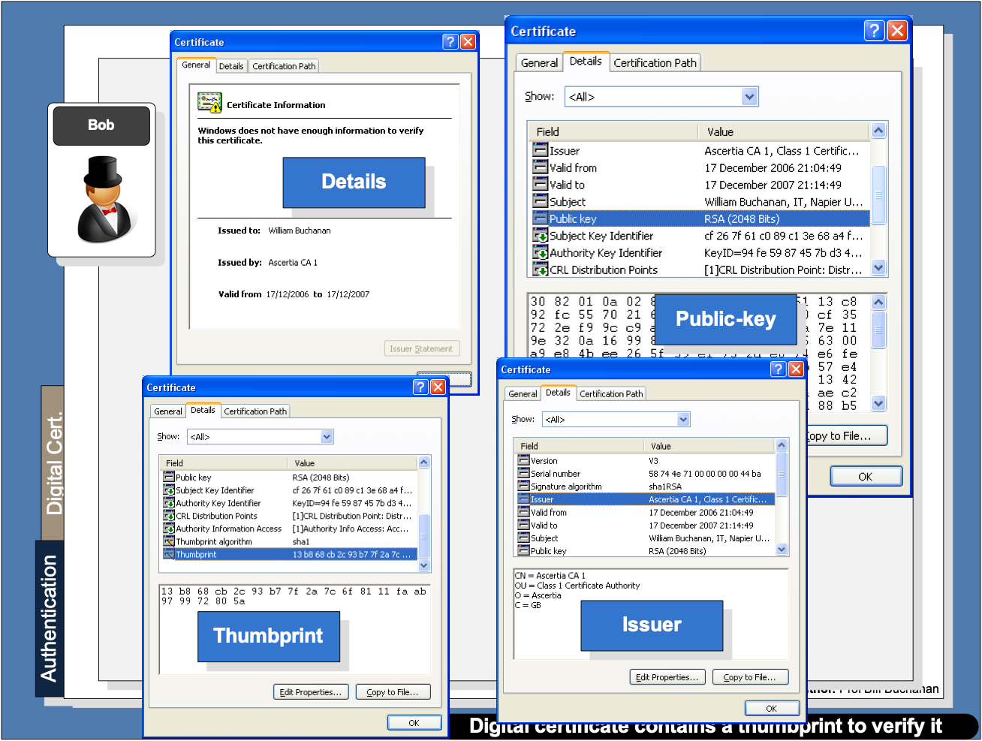

Slide 19
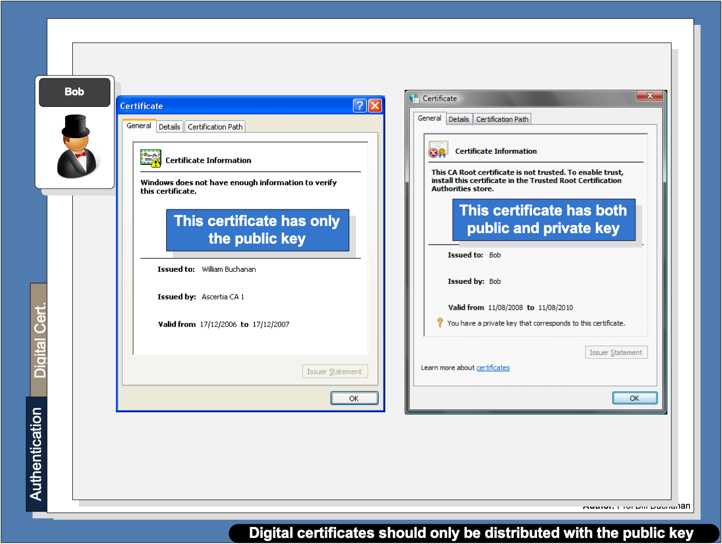

Slide 20
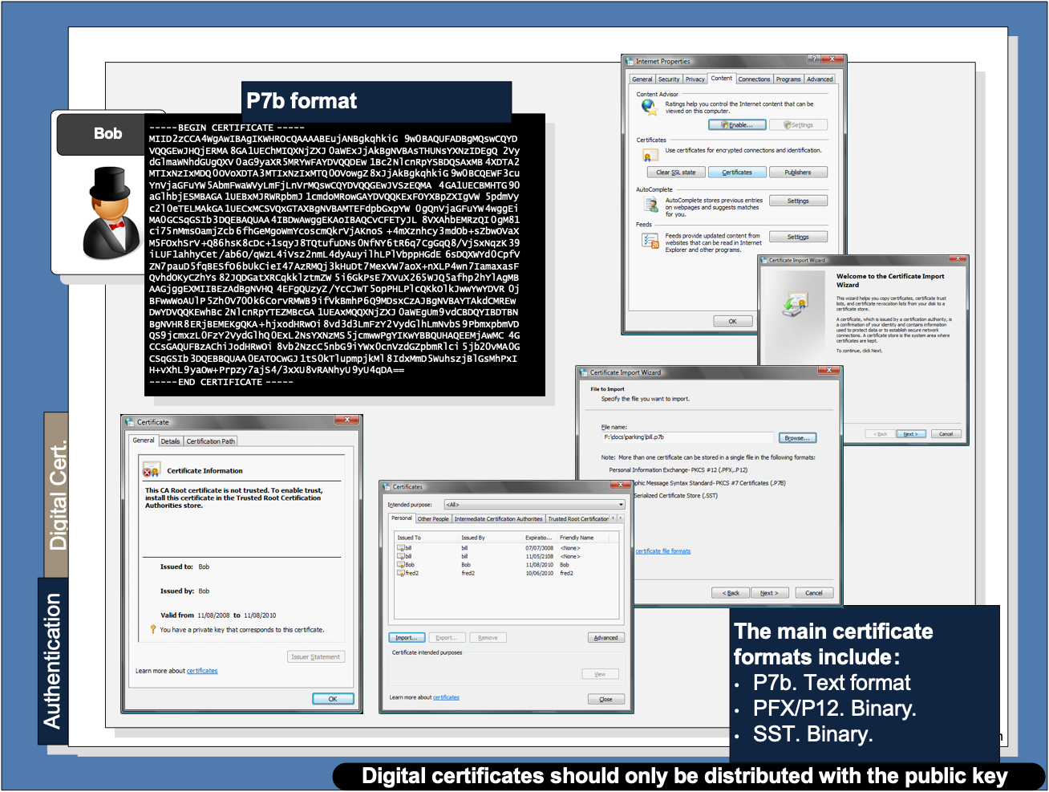

Slide 21
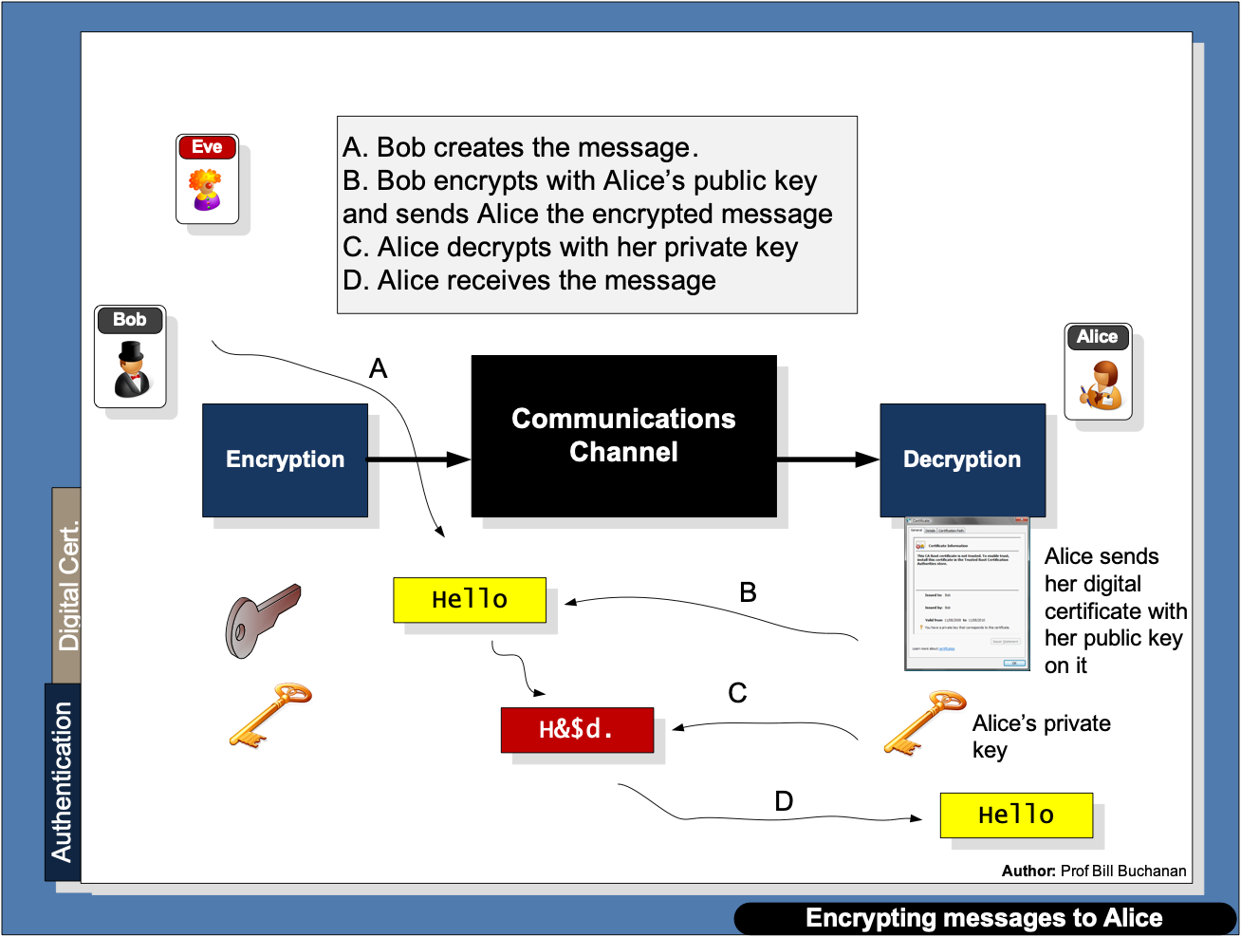

Slide 22
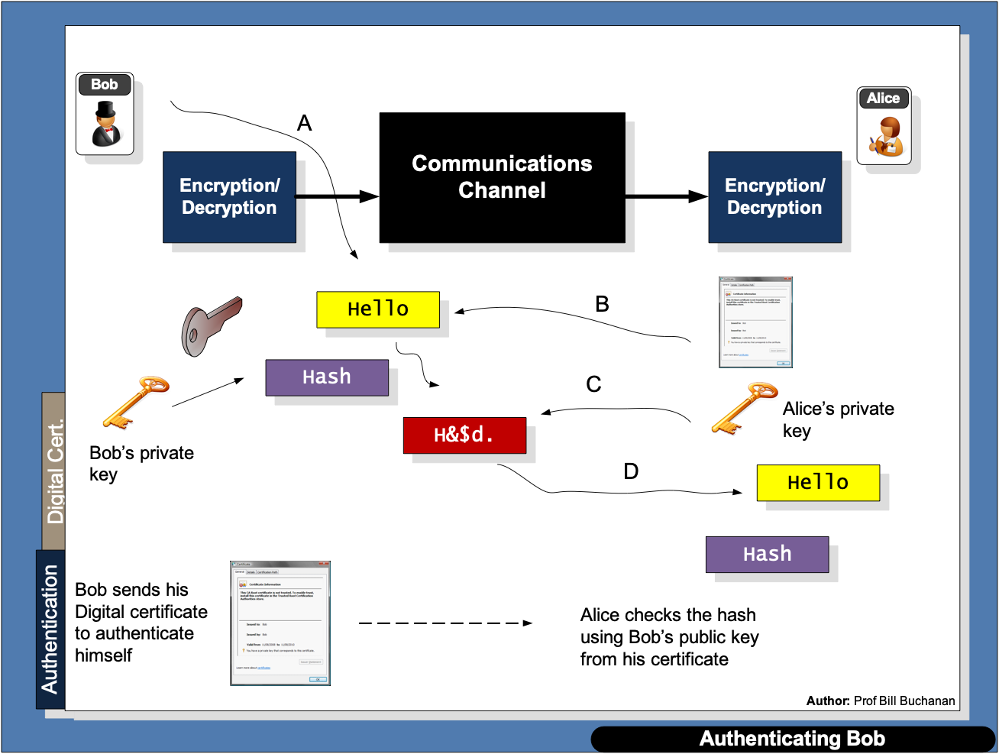

Slide 23
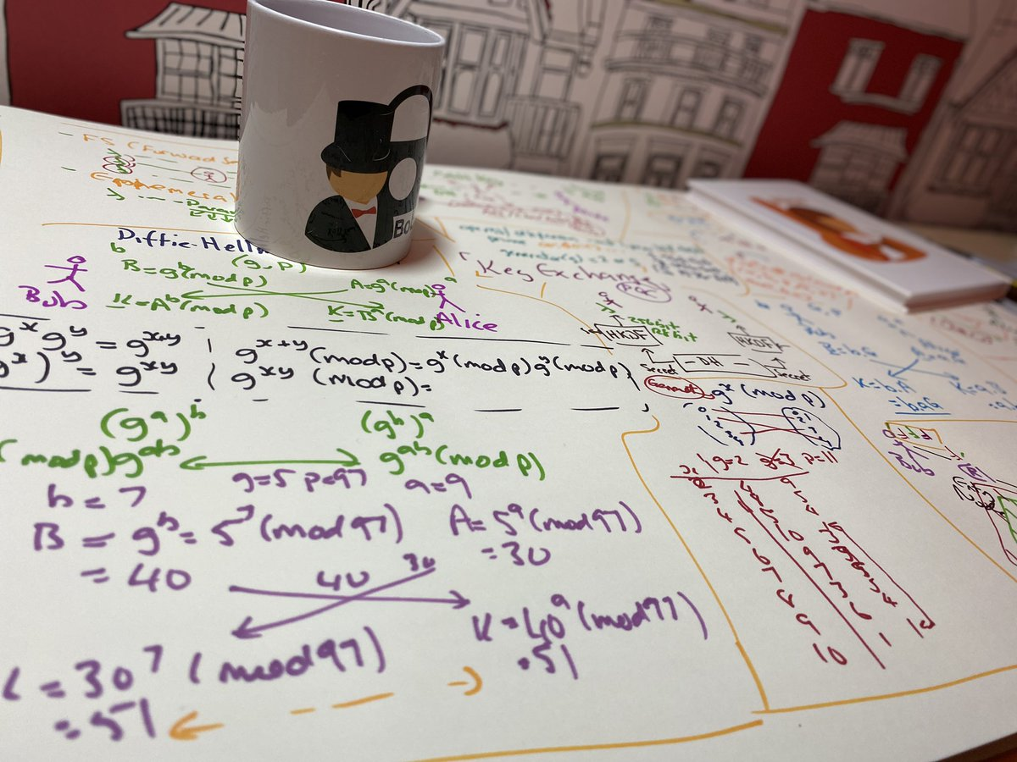
Digital Certificates Introduction Authentication Methods PKI
Certificate Creation Digital Certificate Passing Prof Bill Buchanan OBE https://asecuritysite.com/digitalcert/

Slide 24
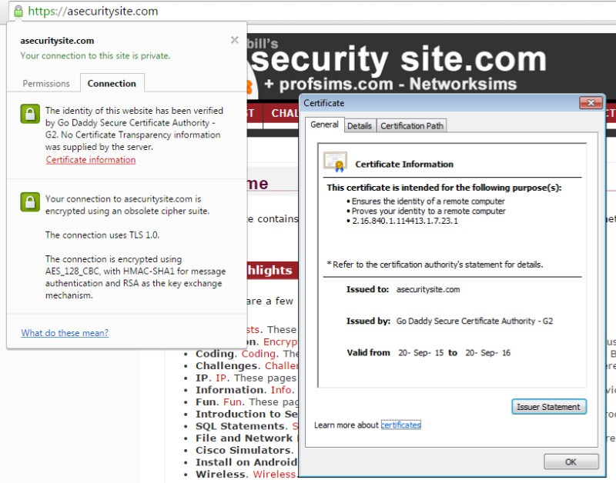
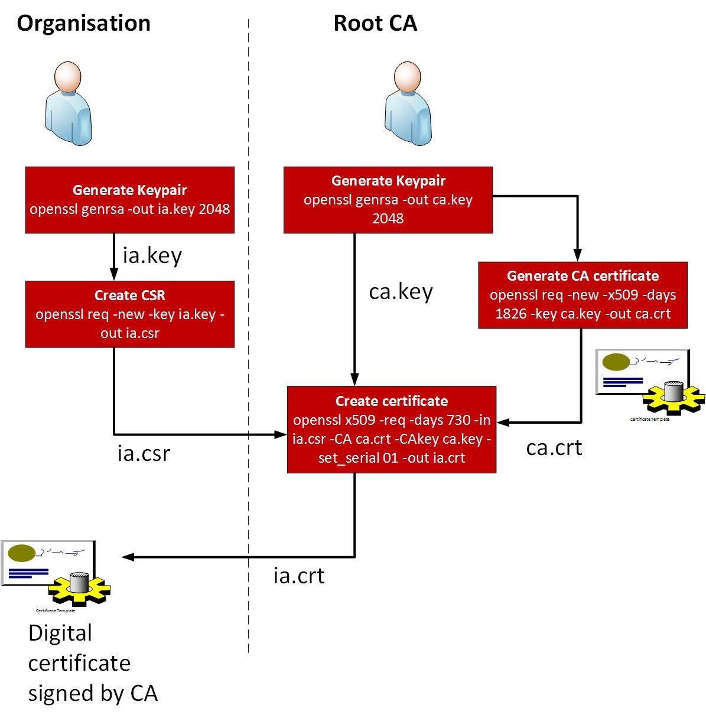


Slide 25

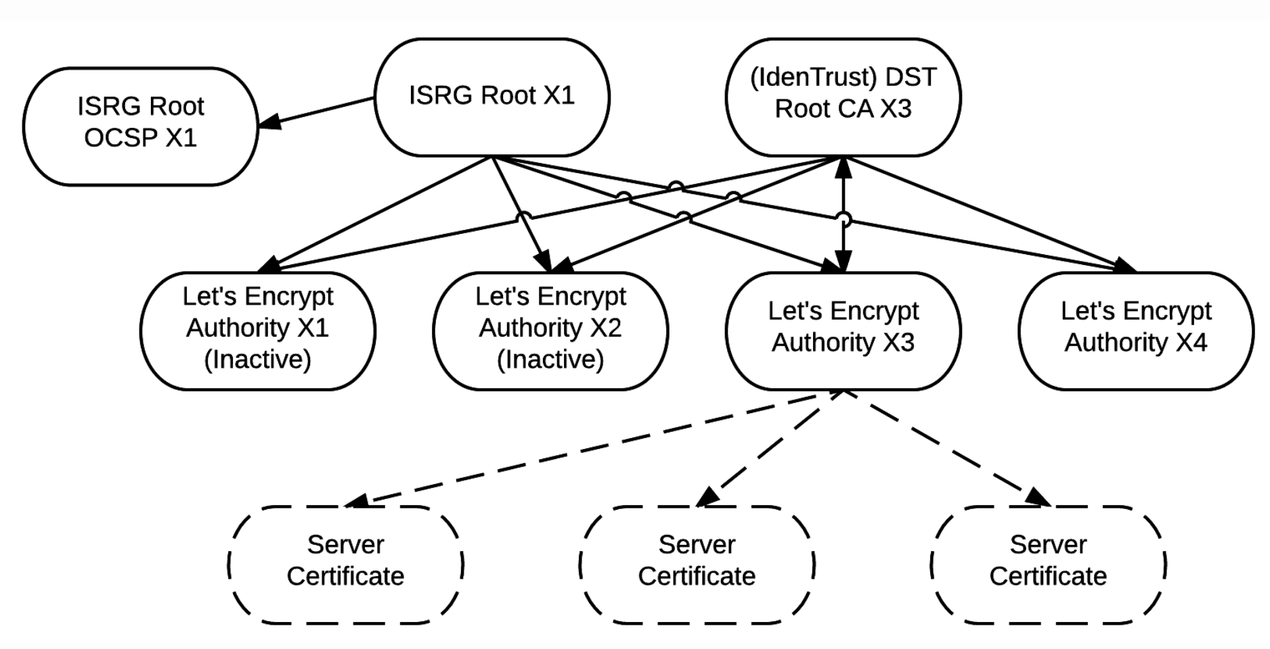

Slide 26
PEM
PKCS#7
-----BEGIN CERTIFICATE-----
MIIEwTCCA6mgAwIBAgIRAO93GGFLfHwOCAAAAAAucZgwDQYJKoZIhvcNAQELBQAw
QjELMAkGA1UEBhMCVVMxHjAcBgNVBAoTFUdvb2dsZSBUcnVzdCBTZXJ2aWNlczET
MBEGA1UEAxMKR1RTIENBIDFPMTAeFw0yMDAyMTIxMTQ3NDFaFw0yMDA1MDYxMTQ3
NDFaMGgxCzAJBgNVBAYTAlVTMRMwEQYDVQQIEwpDYWxpZm9ybmlhMRYwFAYDVQQH
Ew1Nb3VudGFpbiBWaWV3MRMwEQYDVQQKEwpHb29nbGUgTExDMRcwFQYDVQQDEw53
d3cuZ29vZ2xlLmNvbTBZMBMGByqGSM49AgEGCCqGSM49AwEHA0IABCzzLJYFJb8W
TpQxWL0TySDvfEWCkMe7l81CFspT60knl13YILNdTM22sUwPycyogKjBSaQZ9Axi
hCeGEAiJkbejggJVMIICUTAOBgNVHQ8BAf8EBAMCB4AwEwYDVR0lBAwwCgYIKwYB
BQUHAwEwDAYDVR0TAQH/BAIwADAdBgNVHQ4EFgQU9Ty3t90o7UW9+Hc6kv/j9511
BBwwHwYDVR0jBBgwFoAUmNH4bhDrz5vsYJ8YkBug630J/SswZAYIKwYBBQUHAQEE
WDBWMCcGCCsGAQUFBzABhhtodHRwOi8vb2NzcC5wa2kuZ29vZy9ndHMxbzEwKwYI
KwYBBQUHMAKGH2h0dHA6Ly9wa2kuZ29vZy9nc3IyL0dUUzFPMS5jcnQwGQYDVR0R
BBIwEIIOd3d3Lmdvb2dsZS5jb20wIQYDVR0gBBowGDAIBgZngQwBAgIwDAYKKwYB
BAHWeQIFAzAvBgNVHR8EKDAmMCSgIqAghh5odHRwOi8vY3JsLnBraS5nb29nL0dU
UzFPMS5jcmwwggEFBgorBgEEAdZ5AgQCBIH2BIHzAPEAdgCyHgXMi6LNiiBOh2b5
K7mKJSBna9r6cOeySVMt74uQXgAAAXA5cNqwAAAEAwBHMEUCIQCojKtzOe8l1JYK
HmKnbt1puqT4AE3peMVAVk/WeWGp1QIgBvRMbNkwF6i8+JVv3CfTHKvFd8e00+GY
PbXJZb1drKEAdwBep3P531bA57U2SH3QSeAyepGaDIShEhKEGHWWgXFFWAAAAXA5
cNrLAAAEAwBIMEYCIQCQSONppELPODh65oFT5ZAGsSQz4FsjNNZedgS7WqzLnQIh
AMAru0QUuoE3RWngfhI6W7n1kxkEmd0vSZTe6+Ql+JVuMA0GCSqGSIb3DQEBCwUA
A4IBAQCDU8CVusGstVk1lAmrtg3DyYhNV1UnKyLk3RrHKumwYz5mC25bWGoLVKvv
pwxBN3zA329/9JZq0mnn0vmPMxjTDvh9sVQ7g4znwha/KJfzL8AZKUdldD9O+hDO
tlHtqVqITZPCAI/ANvbHdZiMEePB8eA+oTiw2ucChqLlsop5Mio8ckg7aXG4/QfC
AIDbvkoffK44rs4UEpsaqGe9QqMJjTuO7ZCZrFd1m3geq2ARKPHgPoPM6UbDdqgO
TNQo9C0F5ZlOkOgV/qshvpTO4YzE7TB2U571eYEqNXH48syVx8XSk3P7FjM7FIZ2
IzbJSEipZJm8DsP10fFXpToIn+zK
-----END CERTIFICATE-----
-----BEGIN PKCS7-----
MIIE8gYJKoZIhvcNAQcCoIIE4zCCBN8CAQExADALBgkqhkiG9w0BBwGgggTFMIIE
wTCCA6mgAwIBAgIRAO93GGFLfHwOCAAAAAAucZgwDQYJKoZIhvcNAQELBQAwQjEL
MAkGA1UEBhMCVVMxHjAcBgNVBAoTFUdvb2dsZSBUcnVzdCBTZXJ2aWNlczETMBEG
A1UEAxMKR1RTIENBIDFPMTAeFw0yMDAyMTIxMTQ3NDFaFw0yMDA1MDYxMTQ3NDFa
MGgxCzAJBgNVBAYTAlVTMRMwEQYDVQQIEwpDYWxpZm9ybmlhMRYwFAYDVQQHEw1N
b3VudGFpbiBWaWV3MRMwEQYDVQQKEwpHb29nbGUgTExDMRcwFQYDVQQDEw53d3cu
Z29vZ2xlLmNvbTBZMBMGByqGSM49AgEGCCqGSM49AwEHA0IABCzzLJYFJb8WTpQx
WL0TySDvfEWCkMe7l81CFspT60knl13YILNdTM22sUwPycyogKjBSaQZ9AxihCeG
EAiJkbejggJVMIICUTAOBgNVHQ8BAf8EBAMCB4AwEwYDVR0lBAwwCgYIKwYBBQUH
AwEwDAYDVR0TAQH/BAIwADAdBgNVHQ4EFgQU9Ty3t90o7UW9+Hc6kv/j9511BBww
HwYDVR0jBBgwFoAUmNH4bhDrz5vsYJ8YkBug630J/SswZAYIKwYBBQUHAQEEWDBW
MCcGCCsGAQUFBzABhhtodHRwOi8vb2NzcC5wa2kuZ29vZy9ndHMxbzEwKwYIKwYB
BQUHMAKGH2h0dHA6Ly9wa2kuZ29vZy9nc3IyL0dUUzFPMS5jcnQwGQYDVR0RBBIw
EIIOd3d3Lmdvb2dsZS5jb20wIQYDVR0gBBowGDAIBgZngQwBAgIwDAYKKwYBBAHW
eQIFAzAvBgNVHR8EKDAmMCSgIqAghh5odHRwOi8vY3JsLnBraS5nb29nL0dUUzFP
MS5jcmwwggEFBgorBgEEAdZ5AgQCBIH2BIHzAPEAdgCyHgXMi6LNiiBOh2b5K7mK
JSBna9r6cOeySVMt74uQXgAAAXA5cNqwAAAEAwBHMEUCIQCojKtzOe8l1JYKHmKn
bt1puqT4AE3peMVAVk/WeWGp1QIgBvRMbNkwF6i8+JVv3CfTHKvFd8e00+GYPbXJ
Zb1drKEAdwBep3P531bA57U2SH3QSeAyepGaDIShEhKEGHWWgXFFWAAAAXA5cNrL
AAAEAwBIMEYCIQCQSONppELPODh65oFT5ZAGsSQz4FsjNNZedgS7WqzLnQIhAMAr
u0QUuoE3RWngfhI6W7n1kxkEmd0vSZTe6+Ql+JVuMA0GCSqGSIb3DQEBCwUAA4IB
AQCDU8CVusGstVk1lAmrtg3DyYhNV1UnKyLk3RrHKumwYz5mC25bWGoLVKvvpwxB
N3zA329/9JZq0mnn0vmPMxjTDvh9sVQ7g4znwha/KJfzL8AZKUdldD9O+hDOtlHt
qVqITZPCAI/ANvbHdZiMEePB8eA+oTiw2ucChqLlsop5Mio8ckg7aXG4/QfCAIDb
vkoffK44rs4UEpsaqGe9QqMJjTuO7ZCZrFd1m3geq2ARKPHgPoPM6UbDdqgOTNQo
9C0F5ZlOkOgV/qshvpTO4YzE7TB2U571eYEqNXH48syVx8XSk3P7FjM7FIZ2IzbJ
SEipZJm8DsP10fFXpToIn+zKoQAxAA==
-----END PKCS7-----
X.509 Certificate (PEM)
X.509 Certificate (DER)
X.509 Certificate (PKCS#7)
PKCS#1 v2 - Padding for Public Key
PKCS #7 v1.5 - Cryptography Message Syntax
PKCS 10 v1.7 - Certificate Request Standard.
Base64
Base64
openssl x509 -outform der -in www-google-com.pem -out google.crt
openssl pkcs12 -export -in server.pem -out keystore.pkcs12
Binary
DER
CER

Slide 27
Digital Certificates Introduction Authentication Methods PKI Digital Certificate Passing Prof Bill Buchanan OBE https://asecuritysite.com/digitalcert/

Slide 28
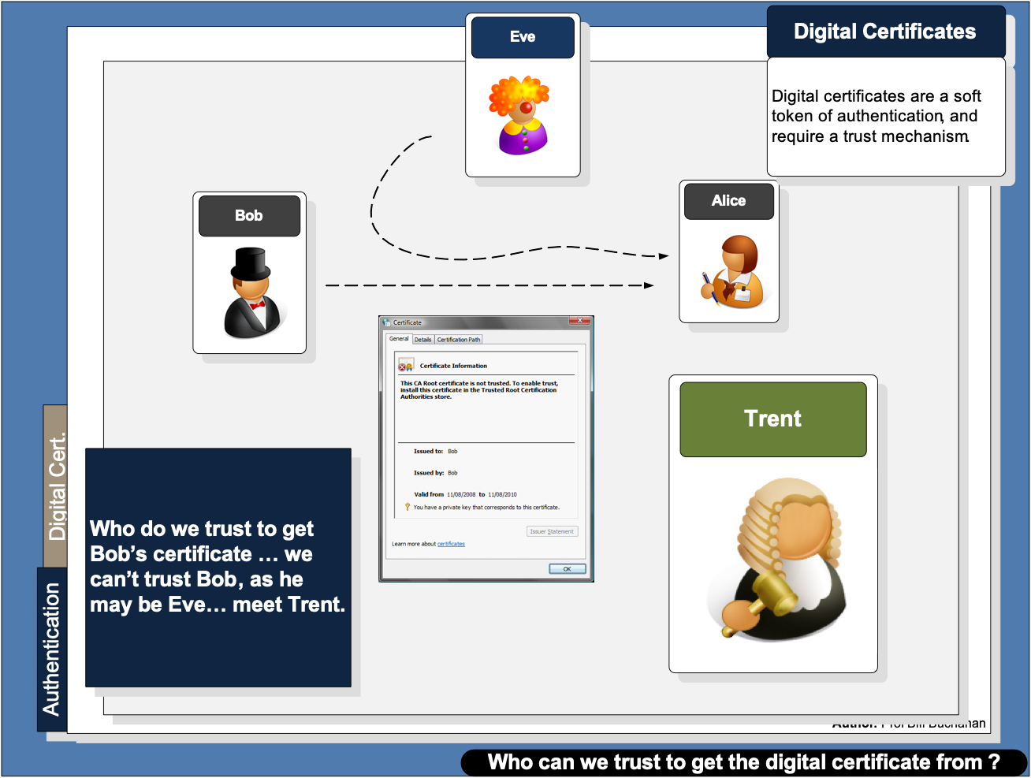

Slide 29
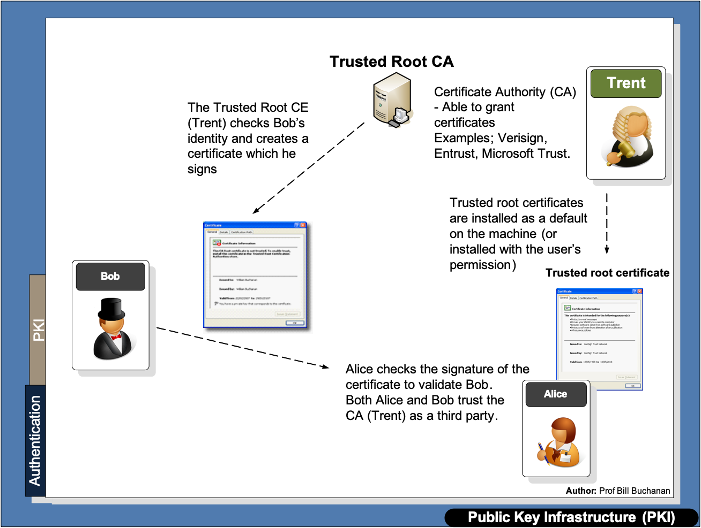

Slide 30
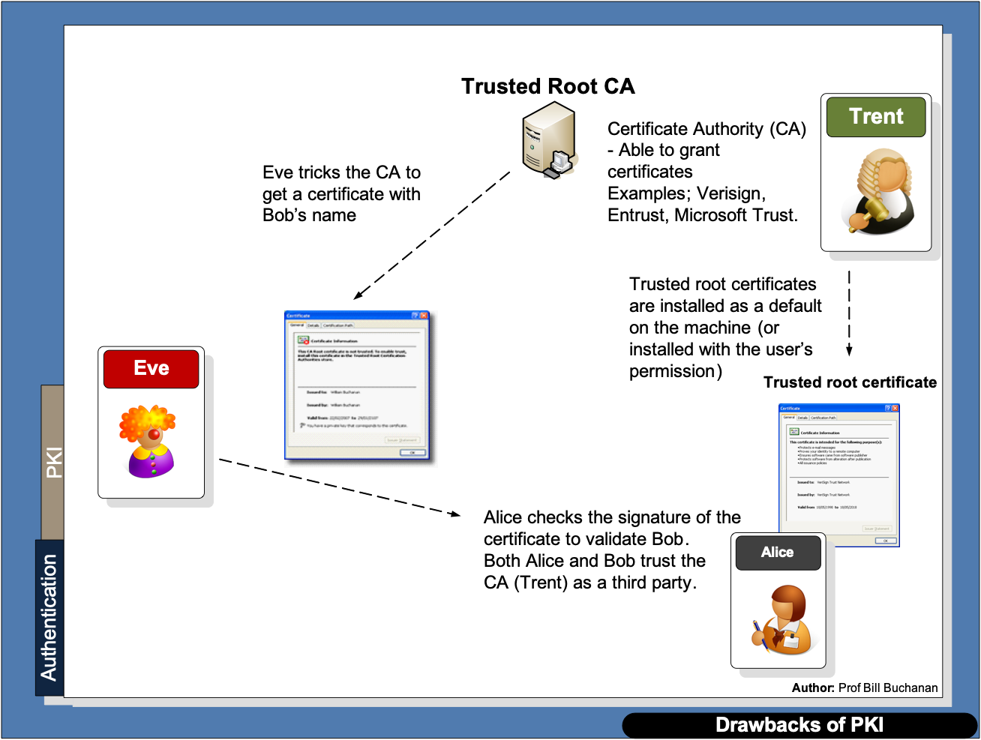

Slide 31
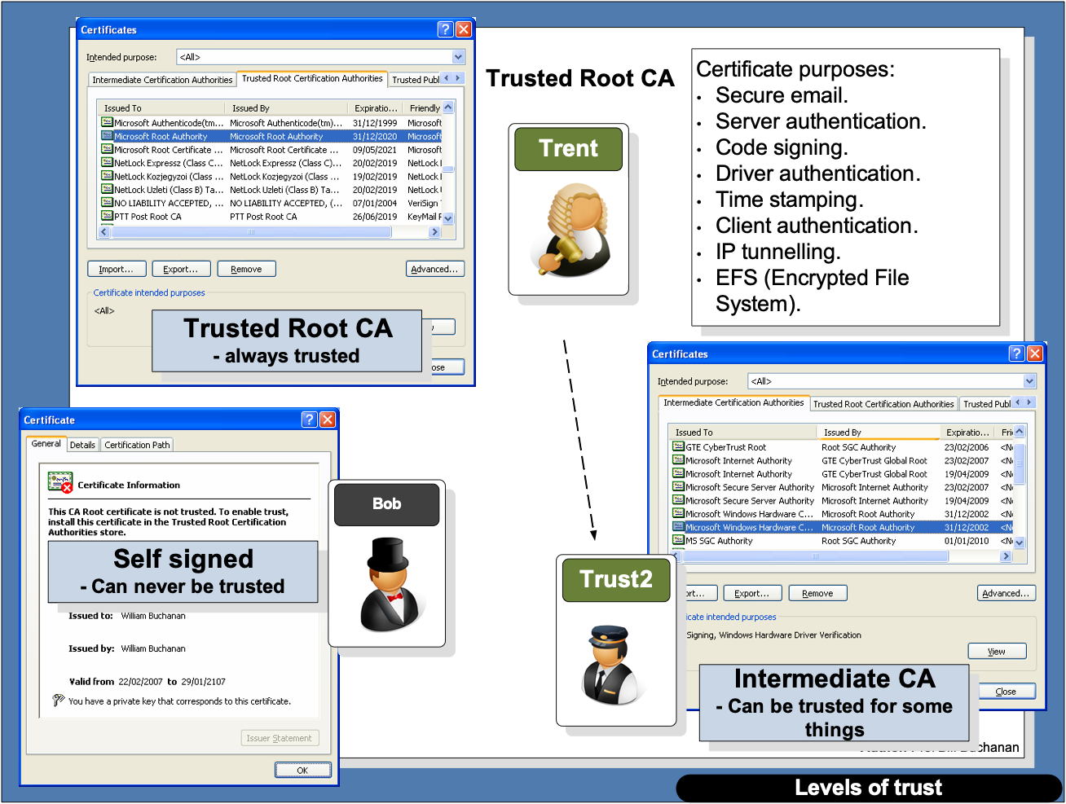

Slide 32
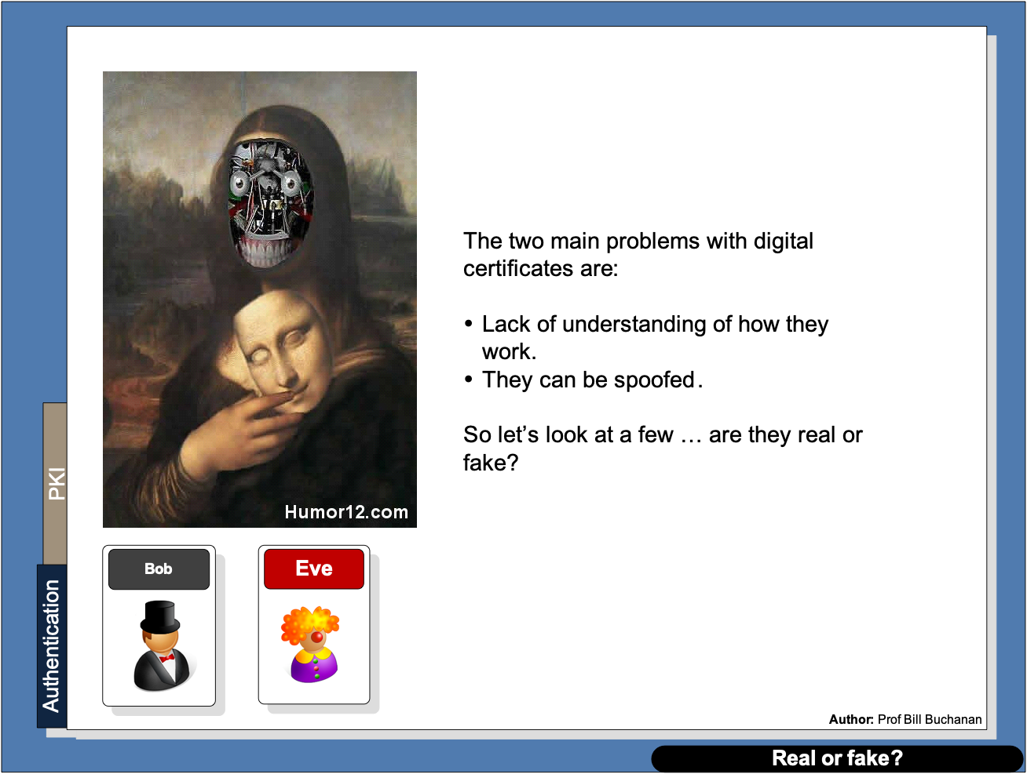

Slide 33
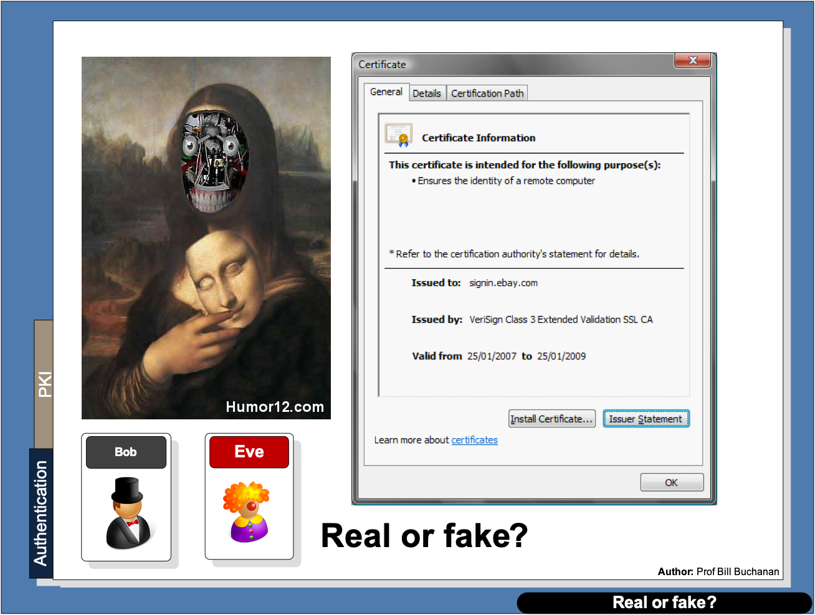

Slide 34
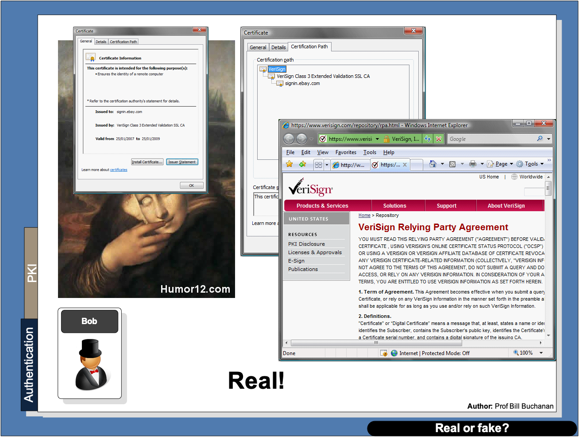

Slide 35
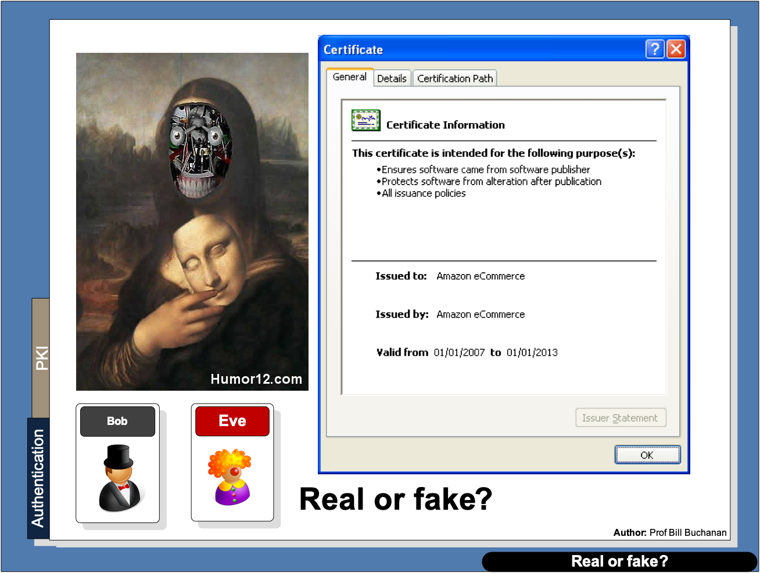

Slide 36
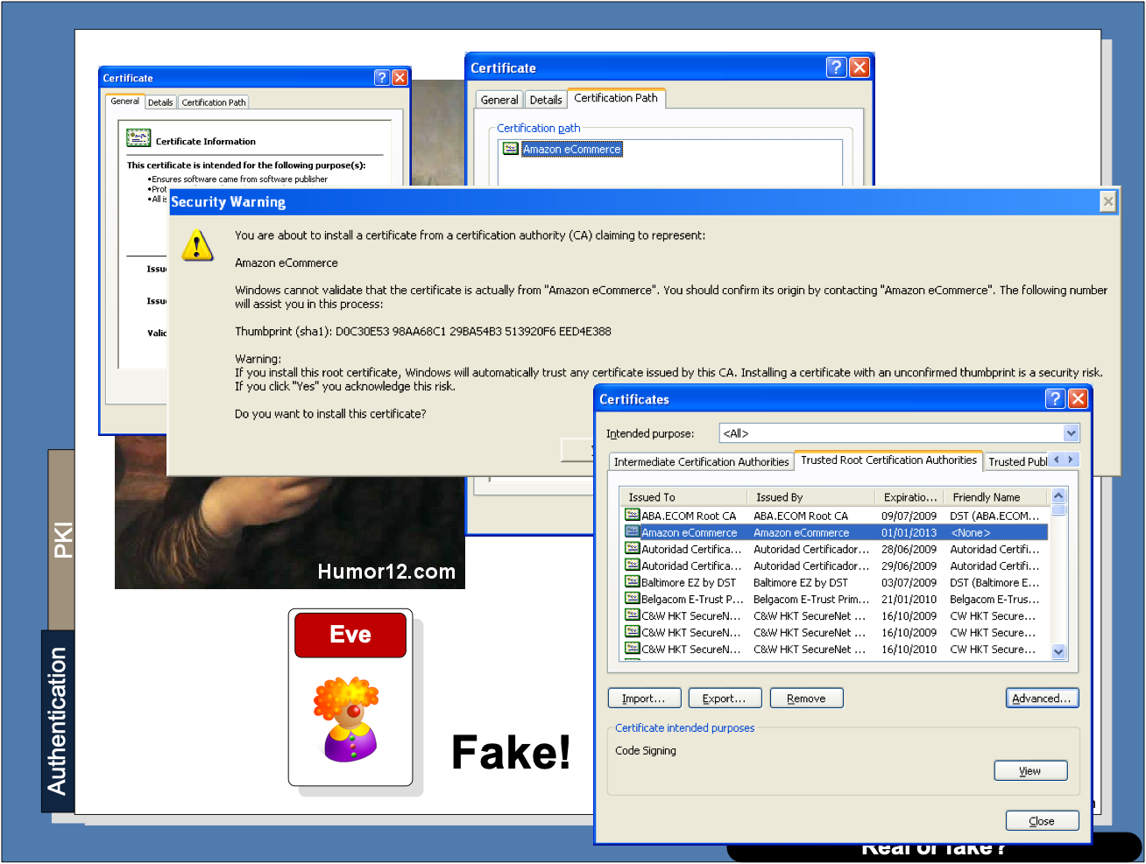

Slide 37


Slide 38
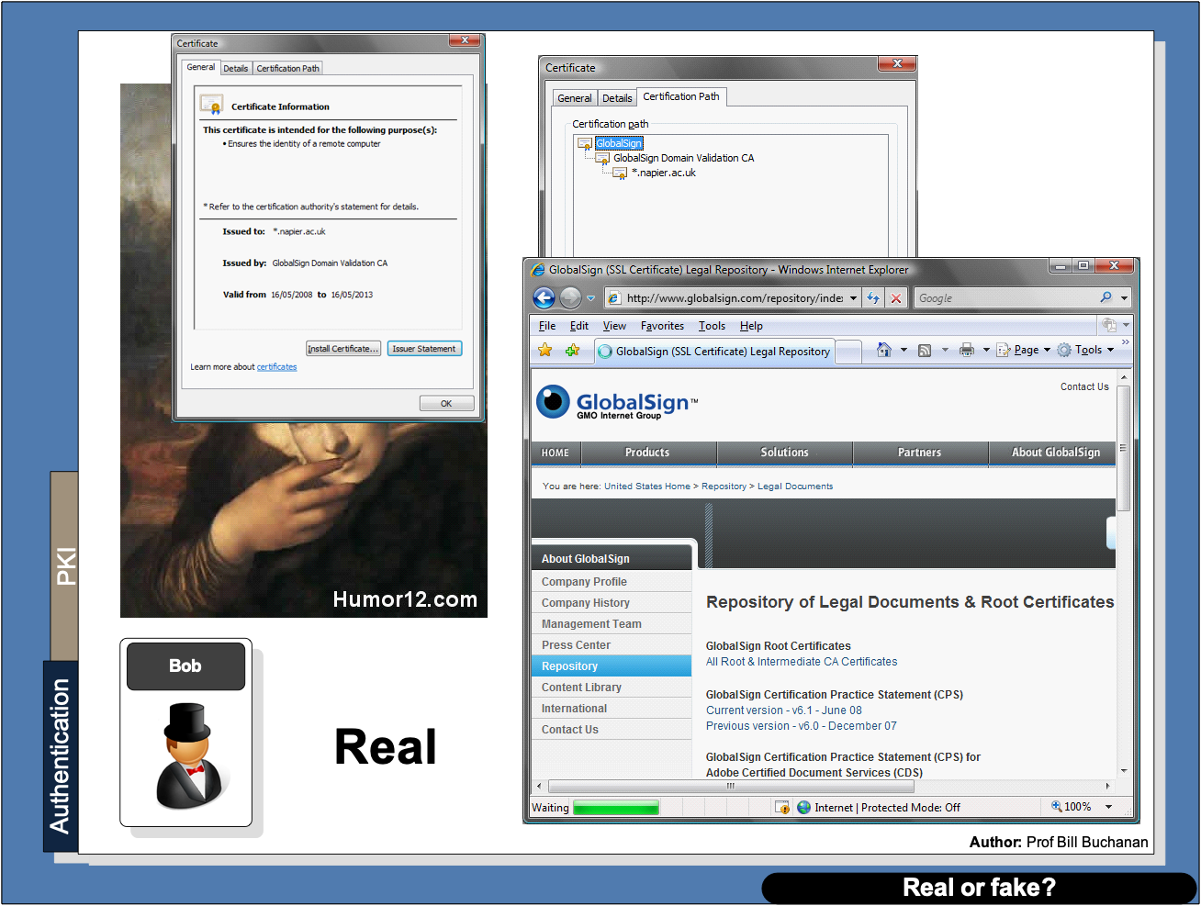

Slide 39
Chapter 6: Digital Certificates Introduction Authentication Methods PKI Digital Certificate Passing Prof Bill Buchanan OBE https://asecuritysite.com/digitalcert/

Slide 40
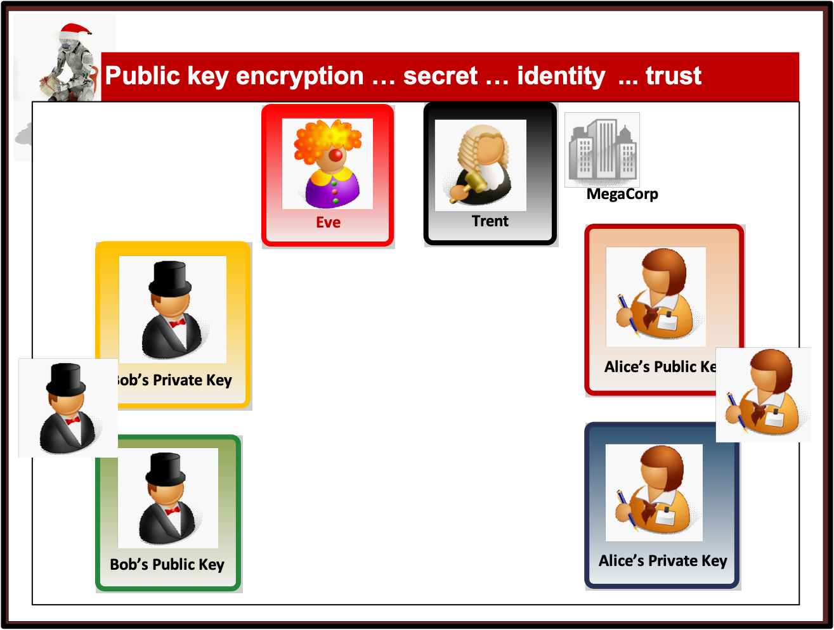

Slide 41
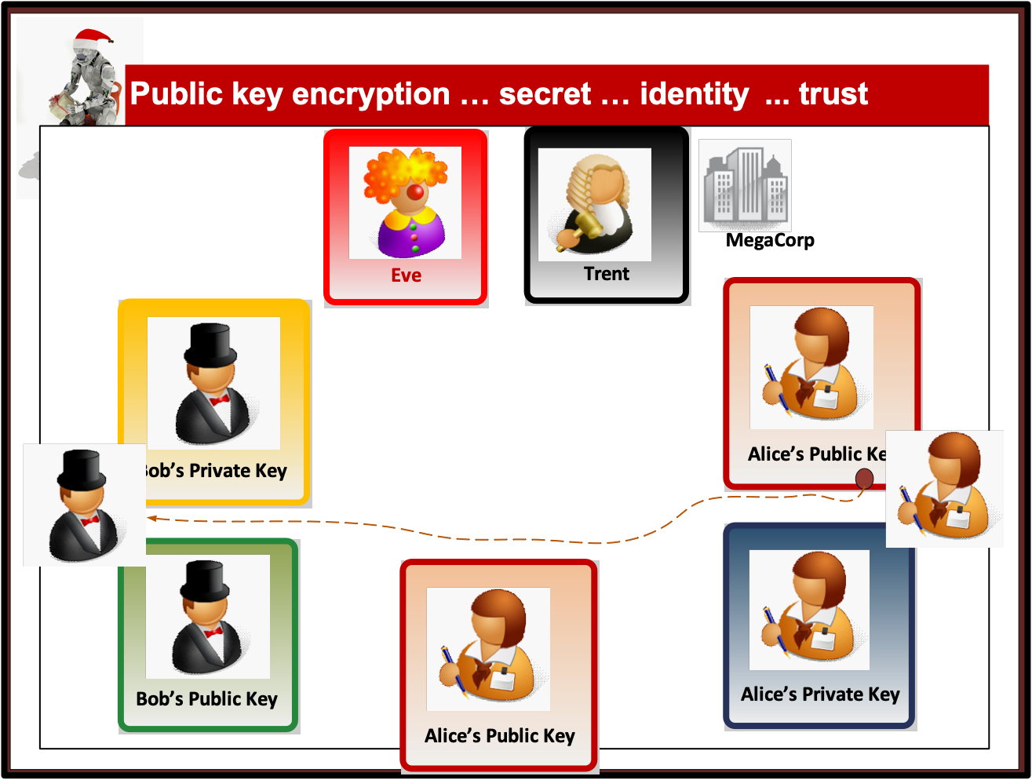

Slide 42
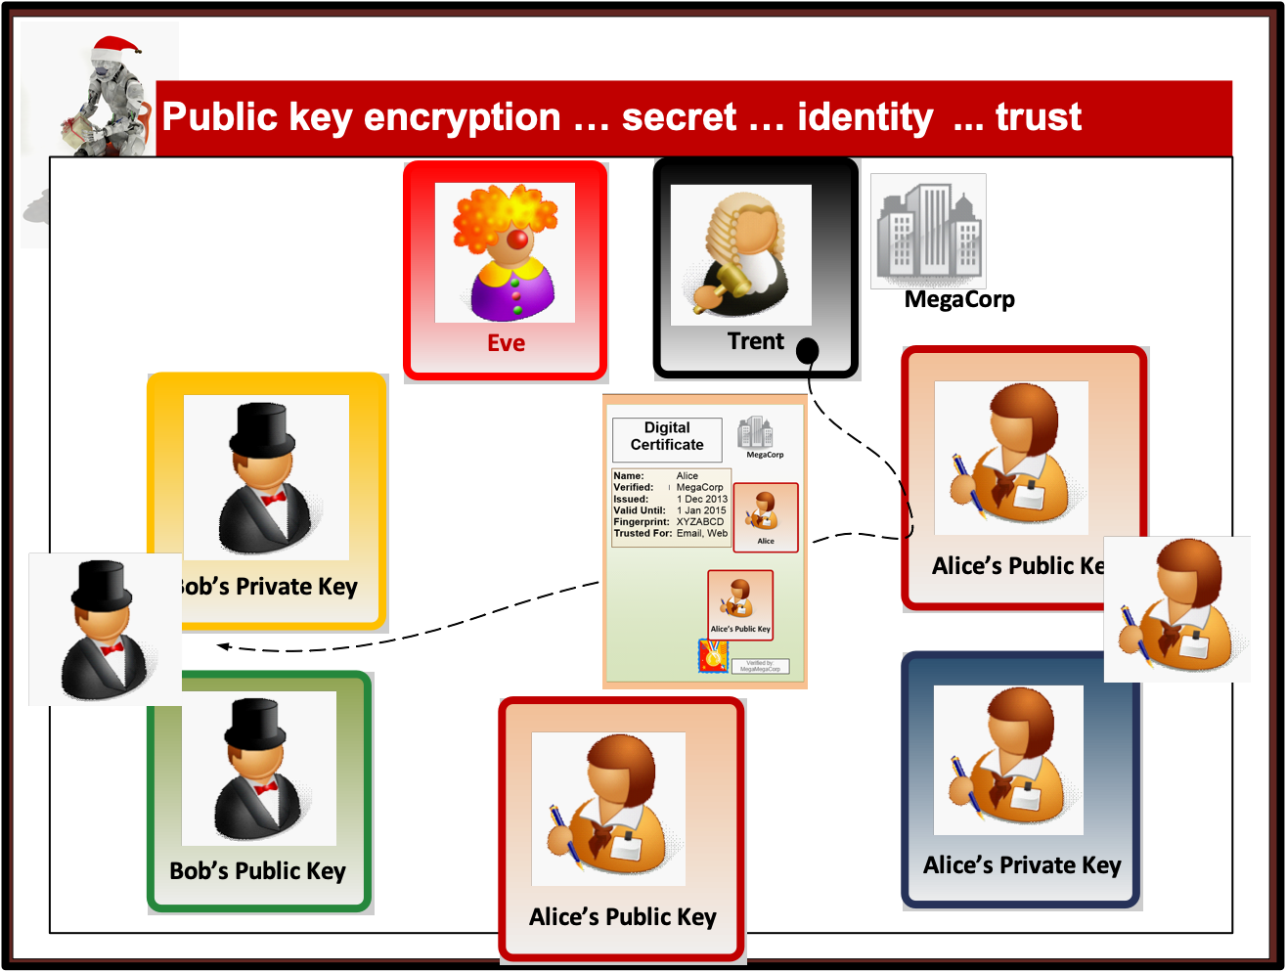

Slide 43
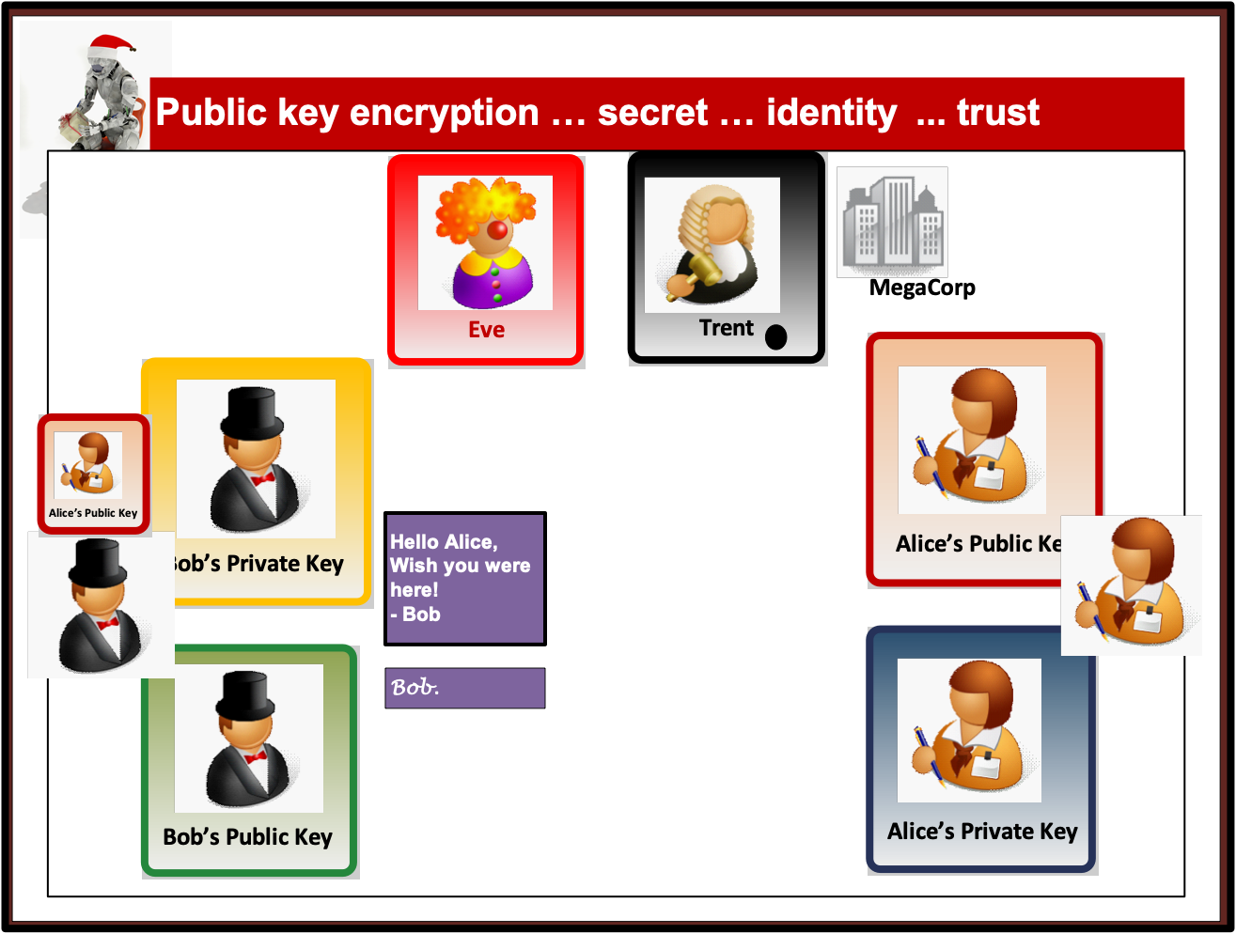

Slide 44
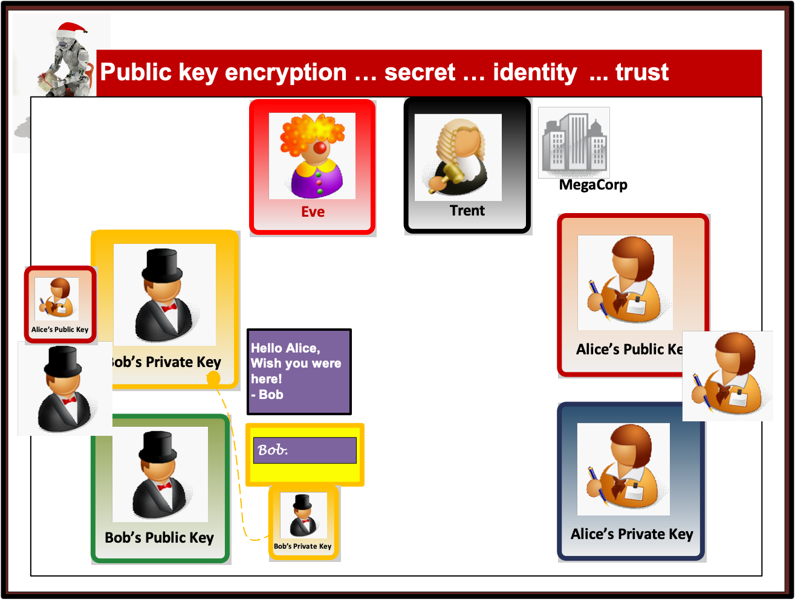

Slide 45
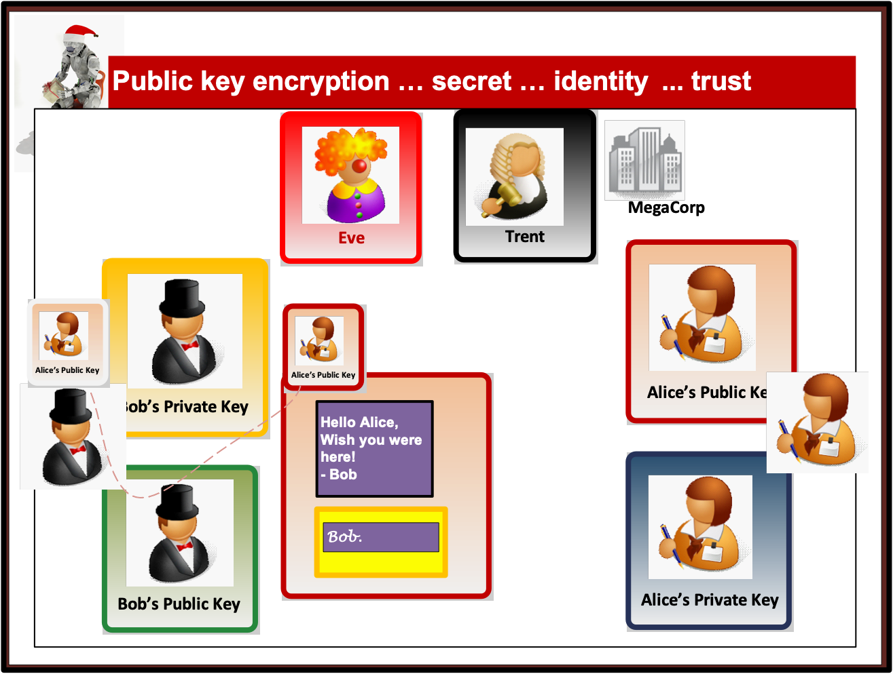

Slide 46
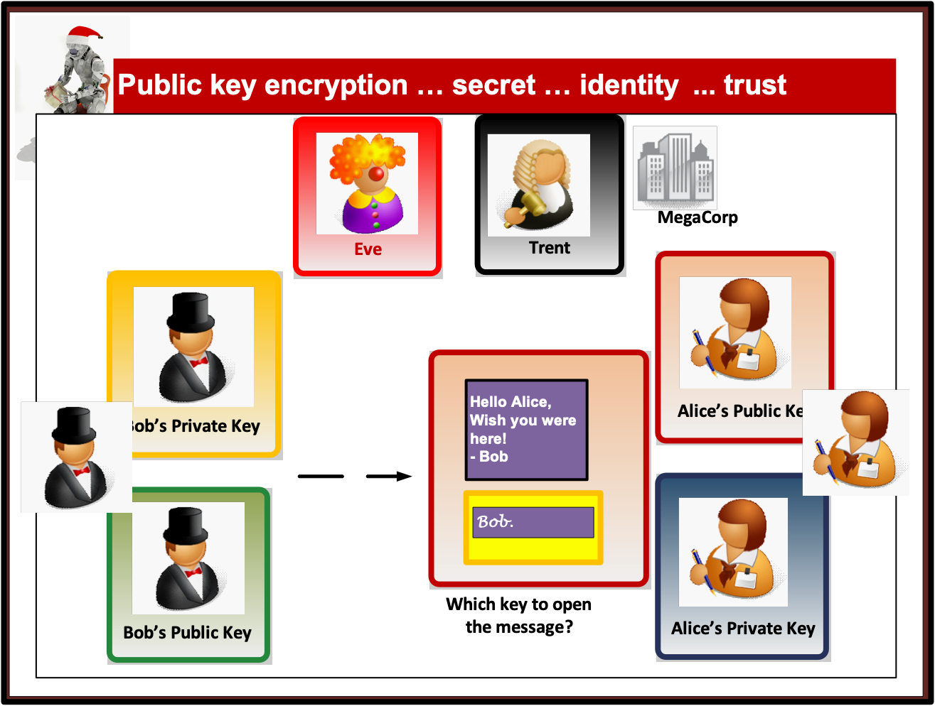

Slide 47
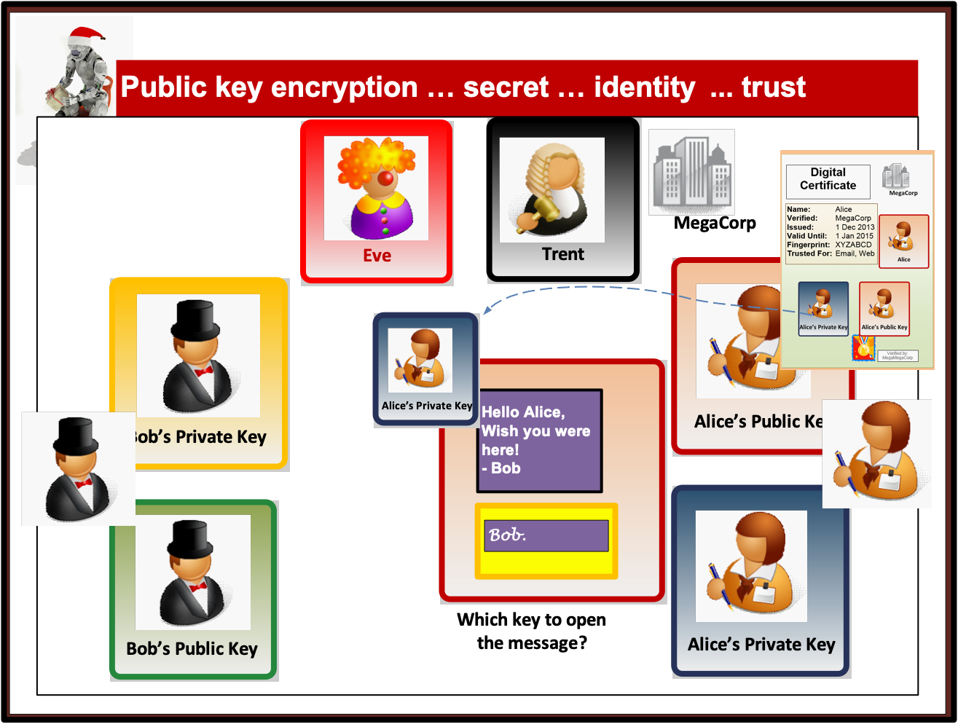

Slide 48
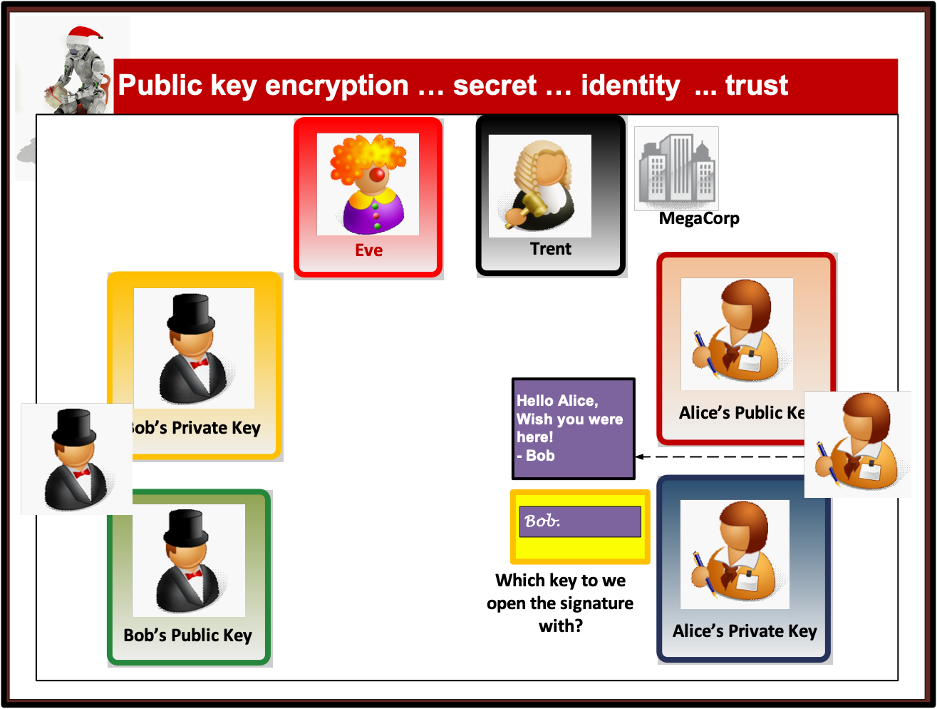

Slide 49
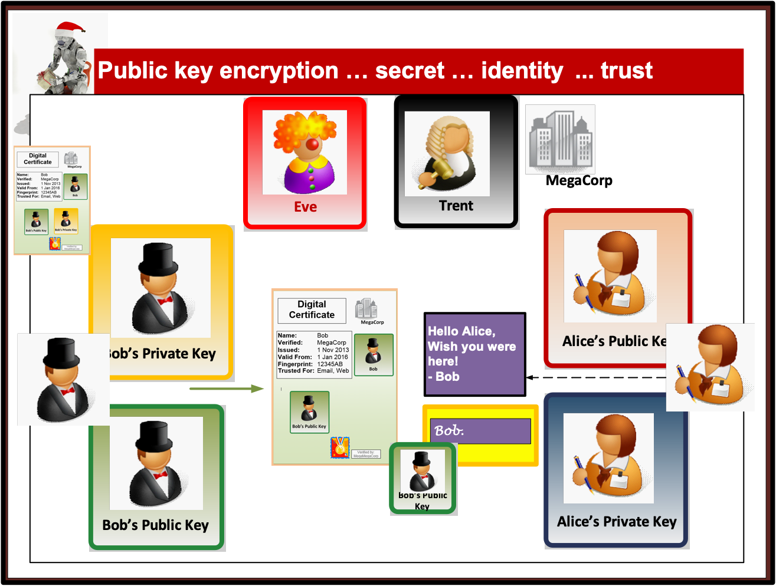

Slide 50
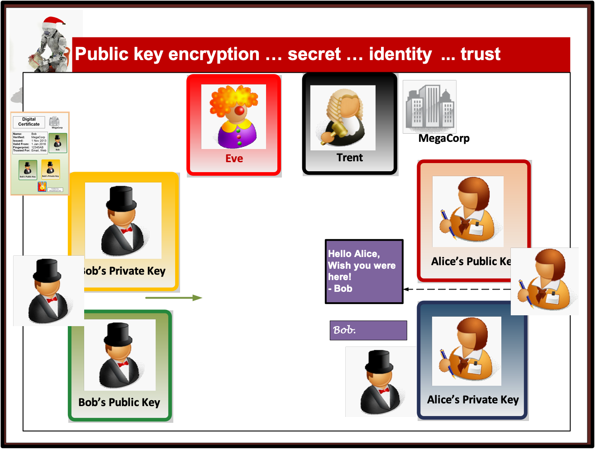

Slide 51
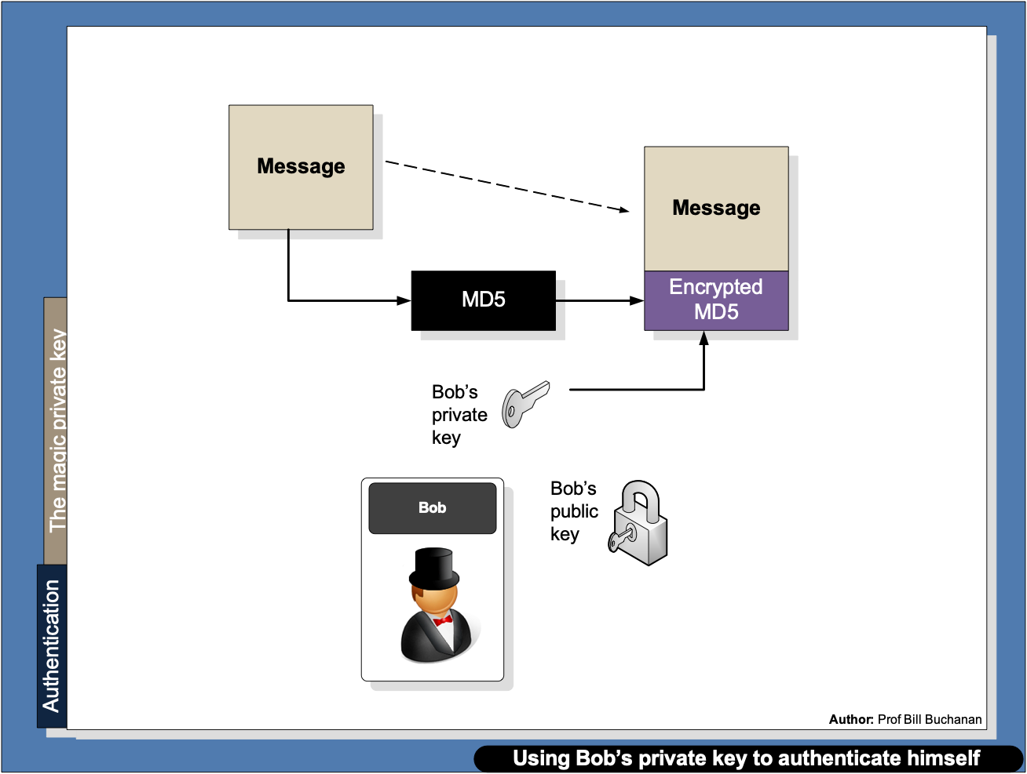

Slide 52
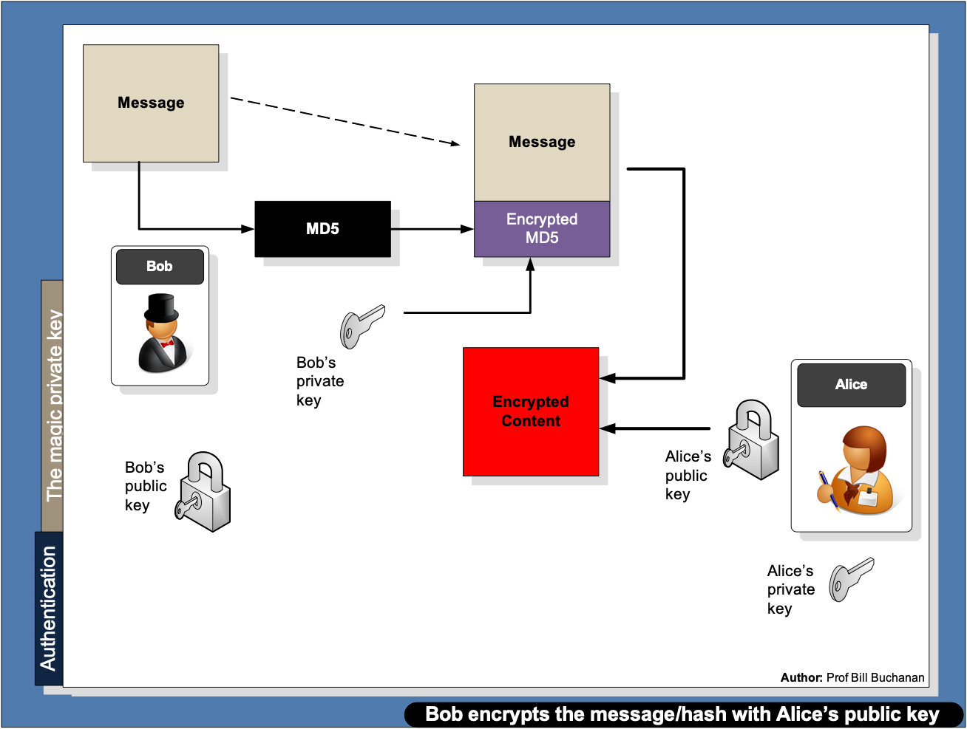

Slide 53
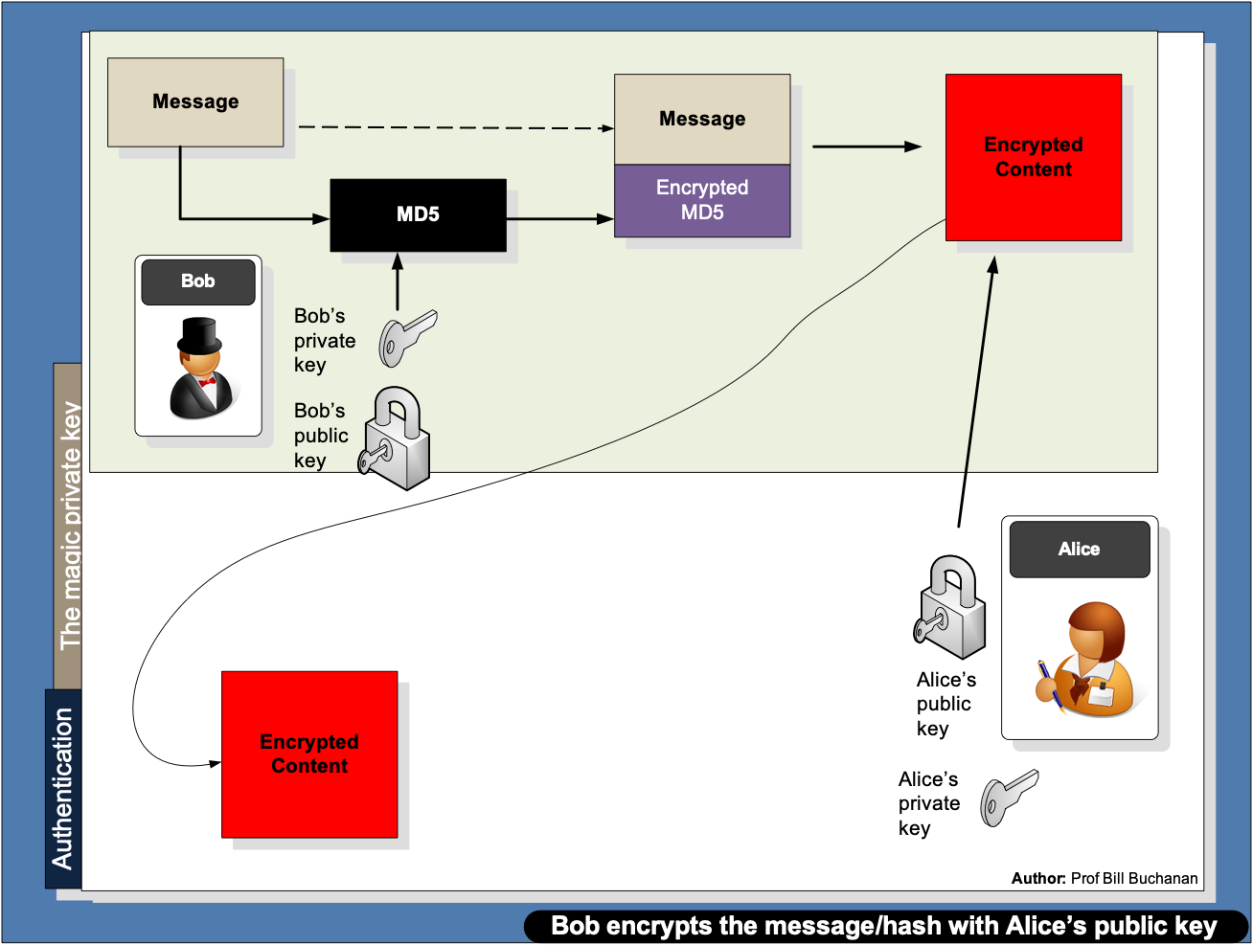

Slide 54
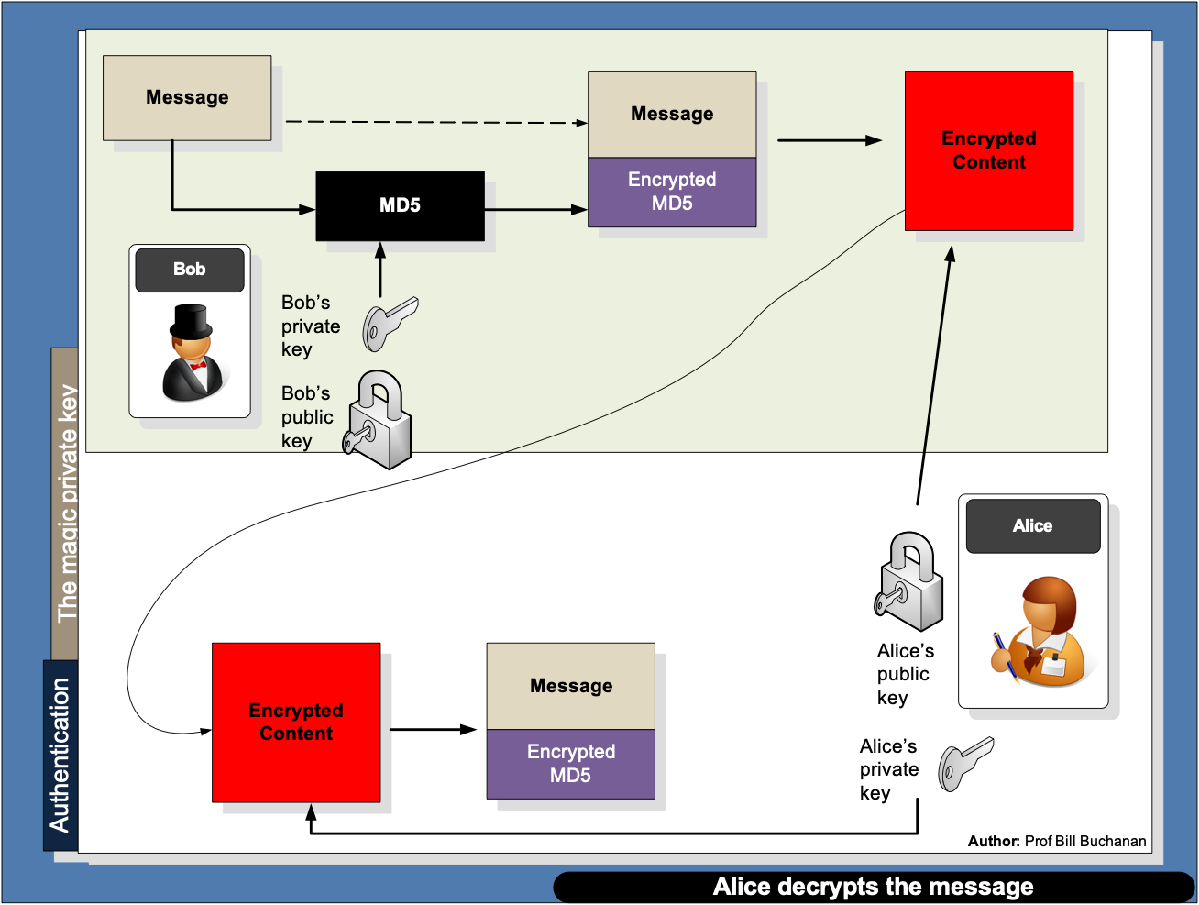

Slide 55


Slide 56
Chapter 6: Digital Certificates Introduction Authentication Methods PKI Digital Certificate Passing Prof Bill Buchanan OBE https://asecuritysite.com/digitalcert/

Slide 57

Overview

Slide 58

Trent

Slide 59


ECDSA

Slide 60

RSA Signatures

Slide 61

Schnorr Signatures – used with EdDSA

Slide 62
Digital Certificates Introduction Authentication Methods PKI Digital Certificate Passing Prof Bill Buchanan OBE https://asecuritysite.com/digitalcert/

